Slide 1







Deep Learning on Graphs for Natural Language Processing
Lingfei Wu, Yu Chen, Heng Ji,
Yunyao Li, and Bang Liu
TheWebConf 2022 Tutorial
April 25th, 2022

Slide 2
Outline
DLG4NLP
Introduction
Why Graphs for NLP?
Conventional ML for NLP
DLG4NLP
Foundations
Graph Construction for NLP
Graph Representation Learning for NLP
DLG4NLP
Applications
Information Extraction
Machine Reading Comprehension
Deep Learning on Graphs: Foundations and Models
Graph Encoder-Decoder Models for NLP
Natural Language Generation
Text Clustering and Matching
Text Mining and Classification
DLG4NLP
Introduction, Foundations, Applications
DLG4NLP
Demos
DLG4NLP Future Directions

Slide 3
DLG4NLP
Introduction

Slide 4
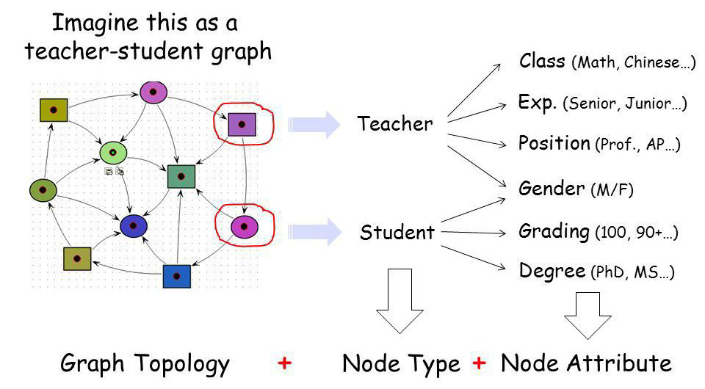
Why graphs?
Graphs are a general language for describing and modeling complex systems
Graph!

Slide 5
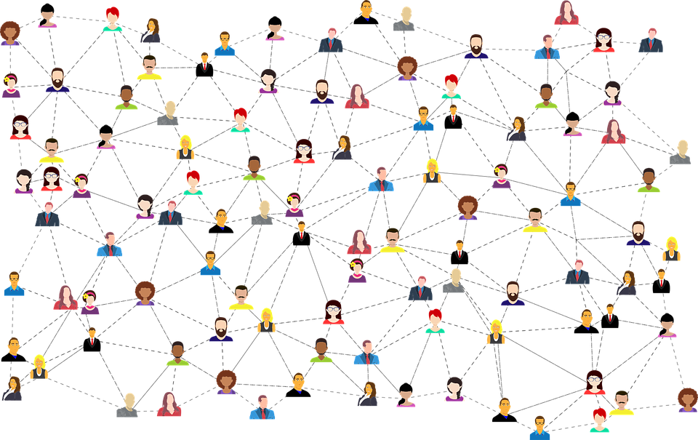

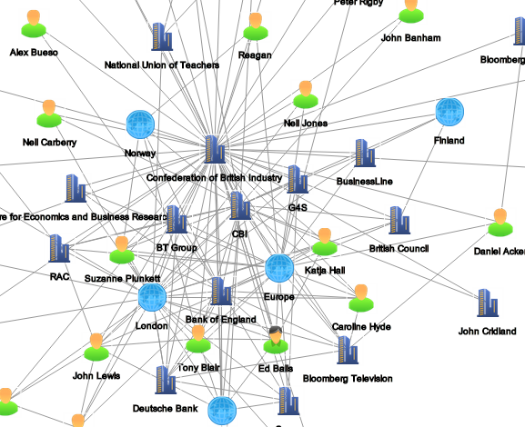
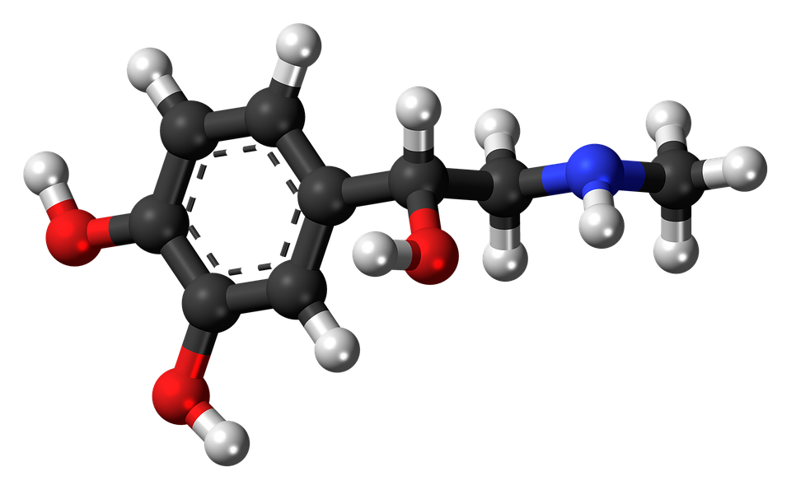
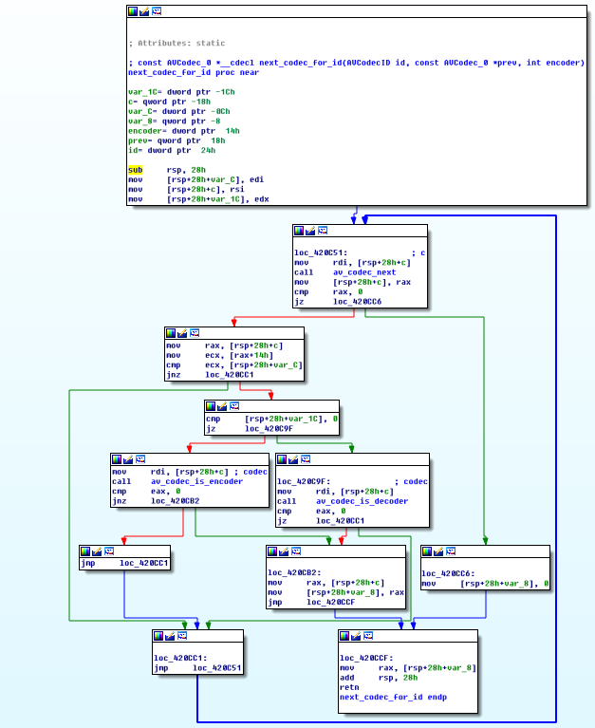
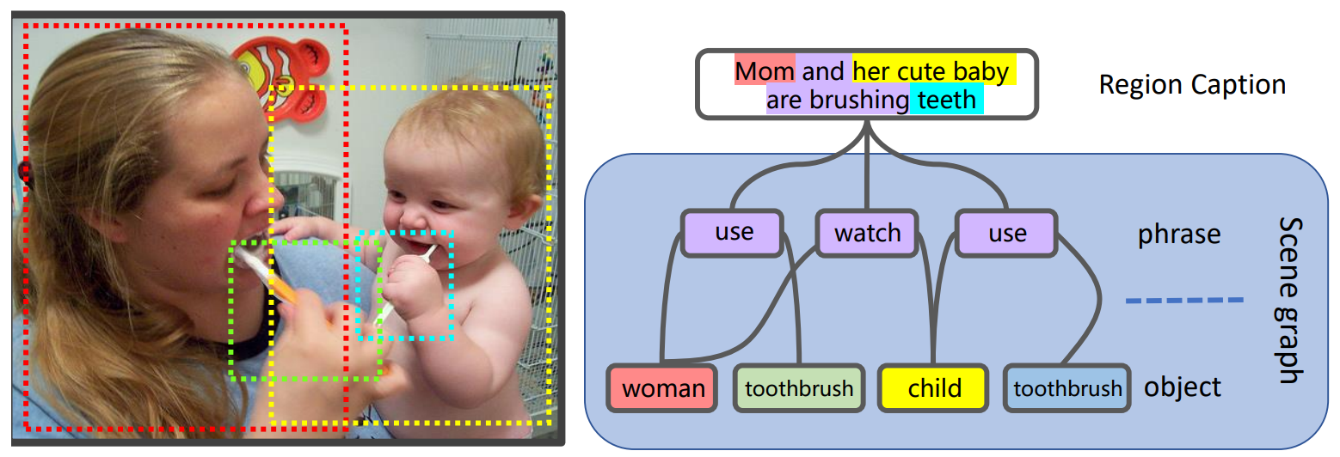
Graph-structured data are ubiquitous
Social networks
Information retrieval
Financial transactions
Biomedical graphs
Scene graphs
Program graphs

Slide 6
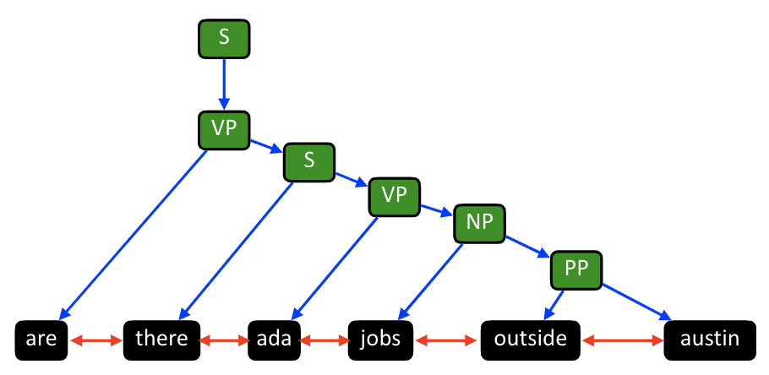
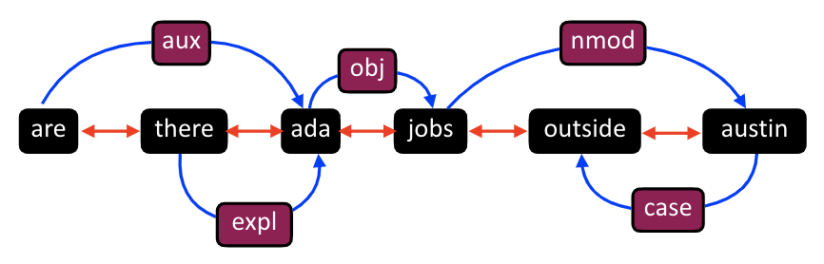
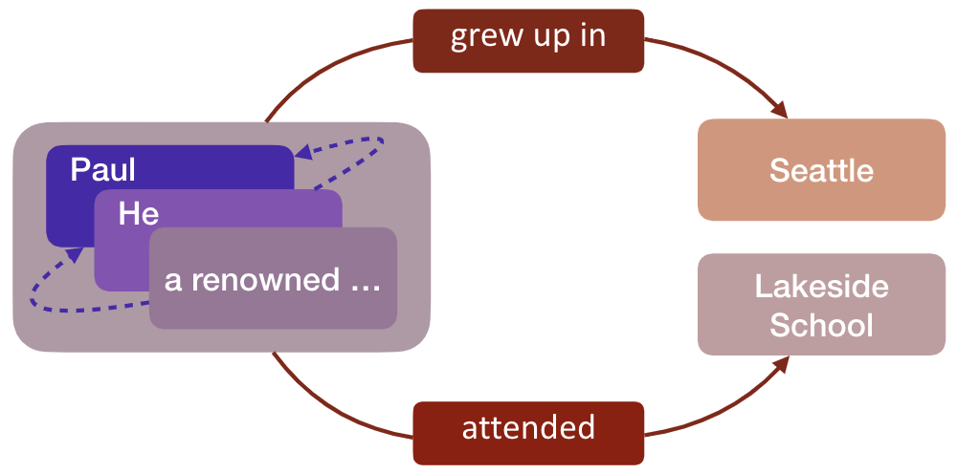
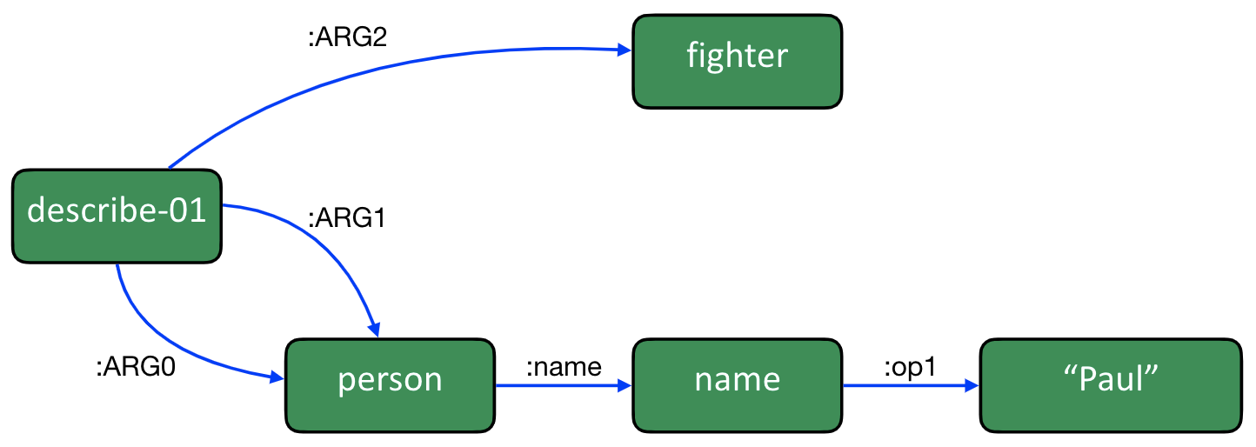
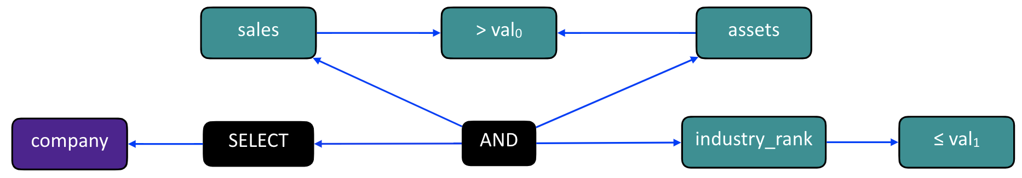
Graphs are ubiquitous in NLP As Well
Constituency graph
Dependency graph
AMR graph
IE graph
SQL graph

Slide 7
Machine Learning on Graphs for NLP

Slide 8
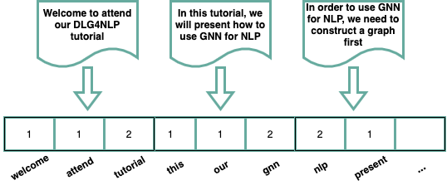
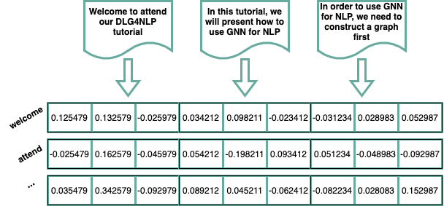
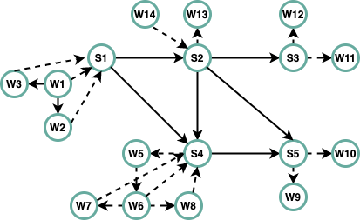
Natural Language Processing: A Graph Perspective
Represent natural language as a bag of tokens
BOW, TF-IDF
Topic Modeling: text as a mixture of topics
Represent natural language as a sequence of tokens
Linear-chain CRF
Word2vec, Glove
Represent natural language as a graph
Dependency graphs, constituency graphs, AMR graphs, IE graphs, and knowledge graphs
Text graph containing multiple hierarchies of elements, i.e. document, sentence and word

Slide 9
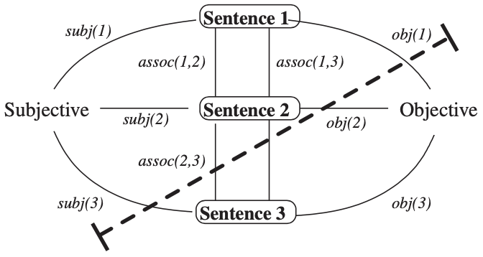
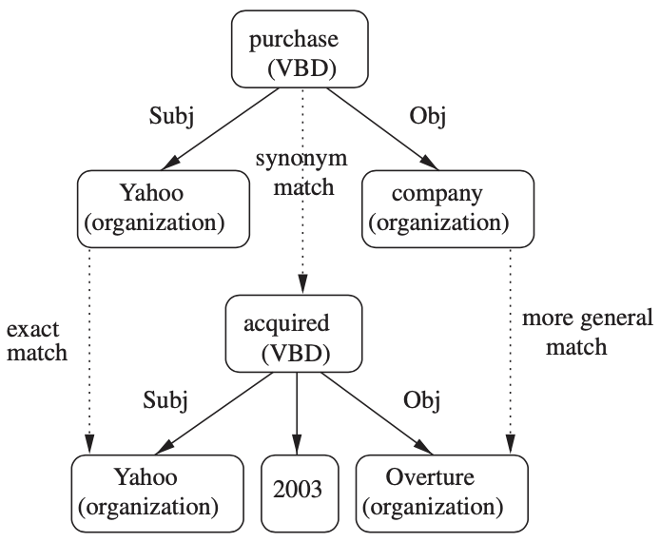
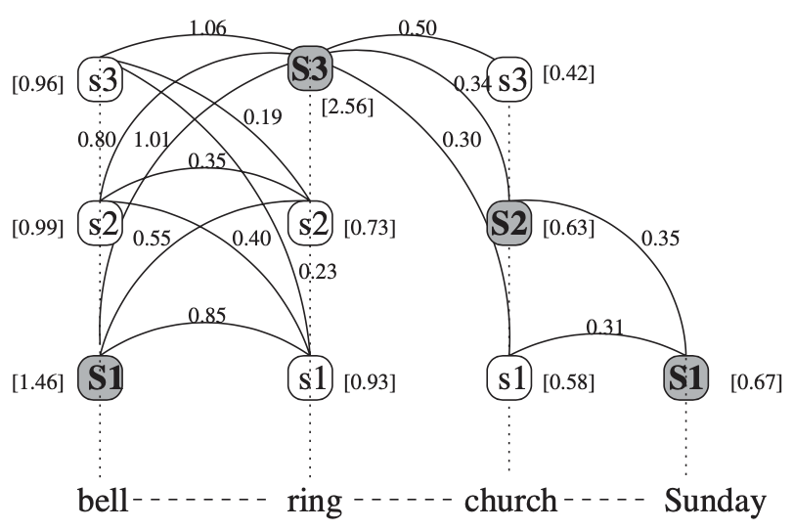
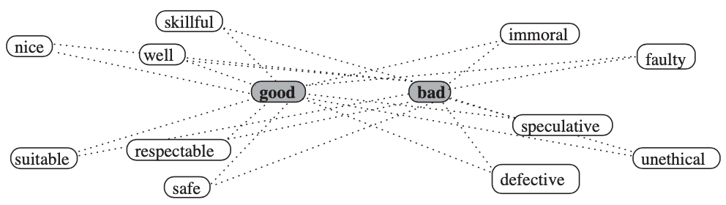
Graph Based Methods for NLP
[Mihalcea and Radev, 2011]
Random Walk Algorithms
Generate random paths, one can obtain a stationary distribution over all the nodes in a graph
Applications: semantic similarity of texts, name disambiguation
Graph Clustering Algorithms
Spectral clustering, random walk clustering and min-cut clustering for text clustering
Graph Matching Algorithms
Compute the similarity between two graphs for textual entailment task
Label Propagation Algorithms
Propagate labels from labeled data points to previously unlabeled data points
Applications: word-sense disambiguation, sentiment analysis

Slide 10
Deep Learning on Graphs: Foundations and Models

Slide 11
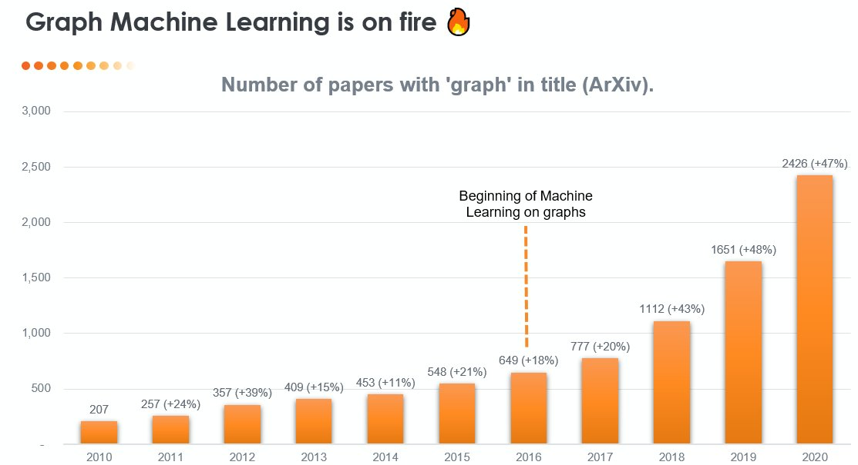
Graph Machine Learning: Recent Trending

Slide 12
Graph Neural Networks: A Brief History
Year 2019-2021
GNNs–based applications,
such as search, Recommendation,
drug discovery, NLP, Transport…
Many open-source Githubs
like DGL, Pytorch Geometric,
Graph4NLP, TorchDrug…
Year 2022
Most comprehensive GNNs
Book (by Dr. L. Wu et al.):
"Graph Neural Networks:
Foundations, Frontiers,
Applications" by Springer
Year 2016, 2017
First GRU-based Modern
GNNs paper: GGNN
First graph convolution-based
paper GCN, Start a new era of
GNNs history
Year 2017-2021
A series of Graph Convolution
(GCN), Message Passage
(MPNN, GraphSage, GIN),
Attention-based (GAT),
Unsupervised GNNs (Graph-
Autoencoder, graph-infomax)
Many new GNNs fast developed!
Year 2021
3 GNN books released simultaneously:
1）Prof. Liu (Tsinghua）et al.:
“Introduction to Graph Neural Networks”
2）Prof. Tang (MSU) et al.:
“Deep learning on graphs”
3）Prof. Hamilton (McGill):
Graph representation learning
Year 2009
First GNNs Paper
(Scarselli et al., 2009)

Slide 13
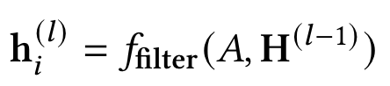
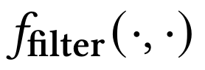
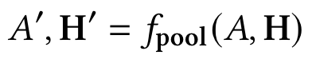
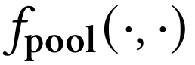
Graph Neural Networks: Foundations
Learning node embeddings:
Learning graph-level embeddings:
A graph filter
adjacency matrix
- Spectral-based
- Spatial-based
- Attention-based
Updated node embeddings
Input node embeddings
- Recurrent-based
Flat Graph Pooling (i.e. Max, Ave, Min)
Hierarchical Graph Pooling (i.e. Diffpool)
A small graph w/
fewer nodes
Input node embeddings
Input graph
New node embeddings
Notes:
The specific models differ only in how 𝑓_filter(·,·) is chosen and parameterized.

Slide 14







Graph Neural Networks: Basic Model
Key idea: Generate node embeddings based on local neighborhoods.
A
TARGET NODE
B
B
C
A
B
A
C
A
C
E
F
D
F
E
D
INPUT GRAPH
A

Slide 15
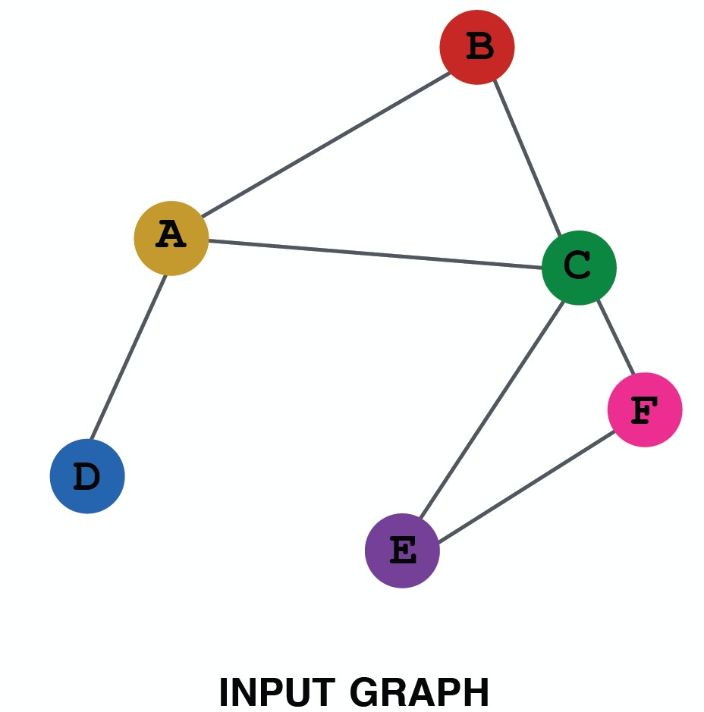
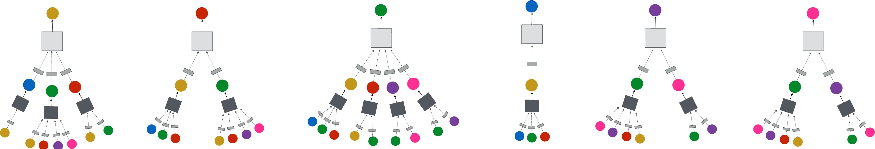
Neighborhood Aggregation
Intuition: Network neighborhood defines a computation graph
Every node defines a unique
computation graph!

Slide 16
Neighborhood Aggregation
Nodes have embeddings at each layer.
Model can be arbitrary depth.
“layer-0” embedding of node i is its input feature, i.e. x_{i}.
Layer-0
Layer-1
A
X_{A}
TARGET NODE
B
C
X_{C}
B
Layer-2
A
B
X_{A}
A
C
X_{B}
A
C
X_{E}
E
F
X_{F}
D
F
E
D
INPUT GRAPH
A
X_{A}

Slide 17
Overview of GNN Model
1) Define a neighborhood aggregation function
A
TARGET NODE
B
B
C
A
B
A
C
Z_{A}
A
C
E
F
D
F
E
D
INPUT GRAPH
A
2) Define a loss function on the embeddings, L(z_{v})

Slide 18
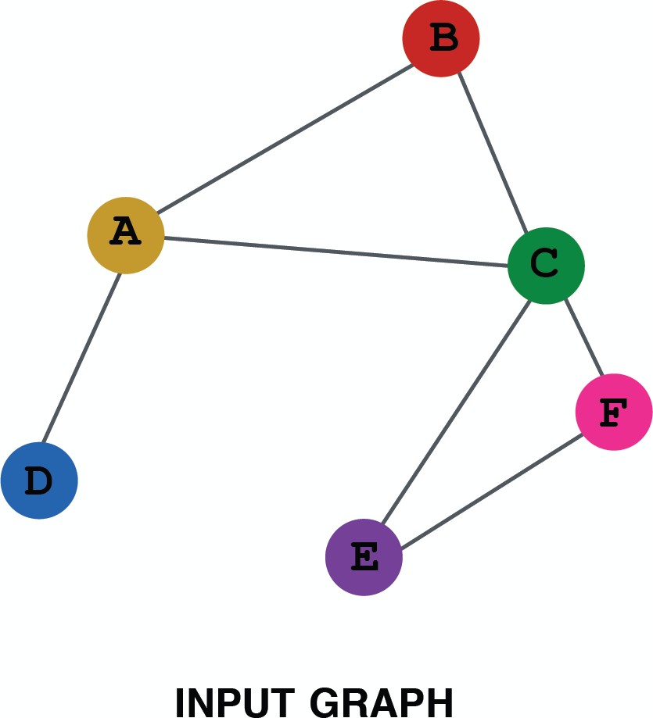
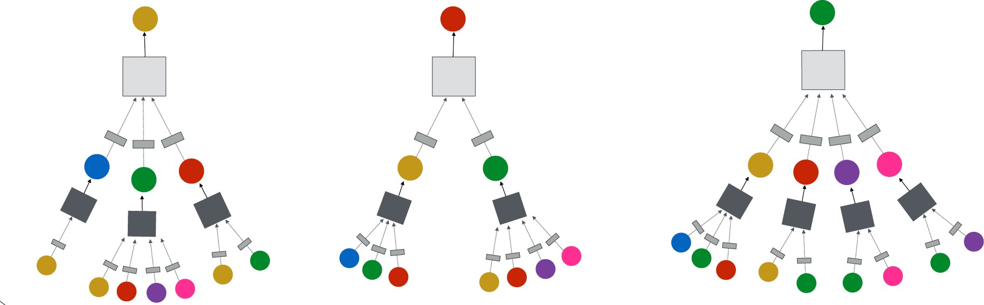
Overview of GNN Model
3) Train on a set of nodes, i.e., a batch of computation graphs

Slide 19
Overview of GNN Model
4) Generate embeddings for nodes as needed
Even for nodes we
never trained on!
19

Slide 20
GNN Model: A Case Study
Basic approach: Average neighbor information and apply a neural network
1) average messages
from neighbors
A
TARGET NODE
B
B
C
A
B
A
C
A
C
E
F
D
F
E
D
INPUT GRAPH
A
2) apply neural network

Slide 21
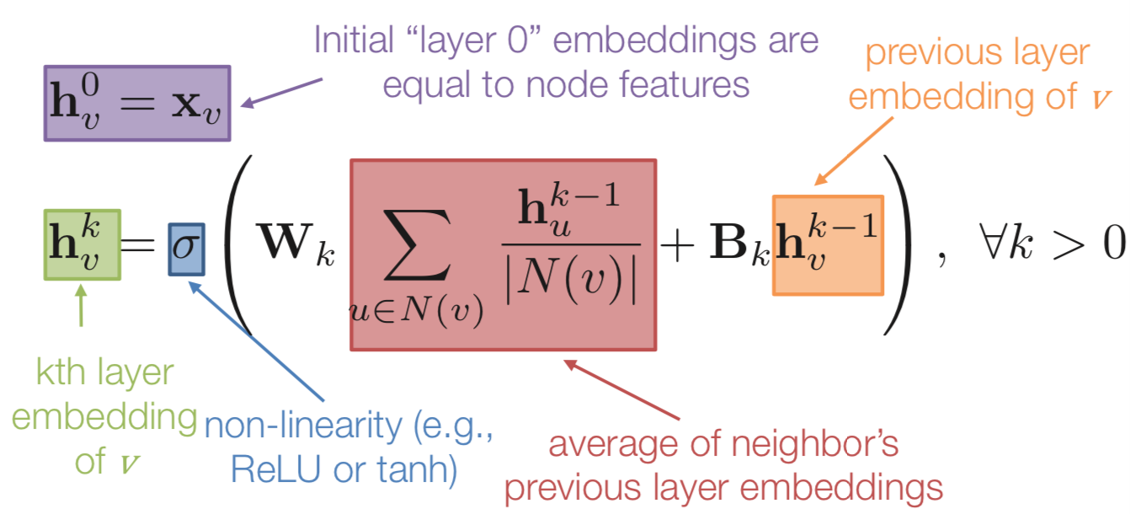
GNN Model: A Case Study
Basic approach: Average neighbor information and apply a neural network.
21

Slide 22
GNN Model: Quick Summary
Key idea: generate node embeddings by aggregating neighborhood information.
Allows for parameter sharing in the encoder
Allows for inductive learning

Slide 23
Graph Neural Networks: Popular Models
Spectral-based Graph Filters
GCN (Kipf & Welling, ICLR 2017), Chebyshev-GNN (Defferrard et al. NIPS 2016)
Spatial-based Graph Filters
MPNN (Gilmer et al. ICML 2017), GraphSage (Hamilton et al. NIPS 2017)
GIN (Xu et al. ICLR 2019)
Attention-based Graph Filters
GAT (Velickovic et al. ICLR 2018)
Recurrent-based Graph Filters
GGNN (Li et al. ICLR 2016)

Slide 24
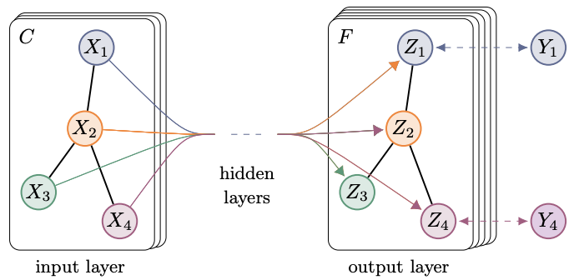
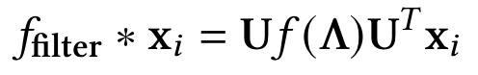
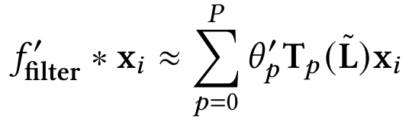
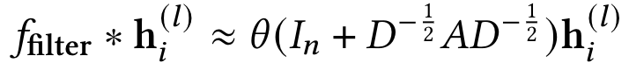
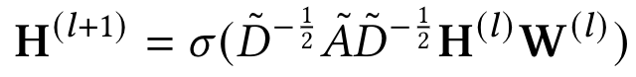
Graph Convolution Networks (GCN)
Key idea: spectral convolution on graphs
Eigen-decomposition
is expensive
Chebyshev polynomials
accelerates but still not
powerful
GCN in NLP Tasks:
Text classification
Question Answering
Text Matching
Topic Modeling
Information Extration
First-order approxima-
tion fast and powerful
Renormalization trick
stabilizes the numerical
computation

Slide 25
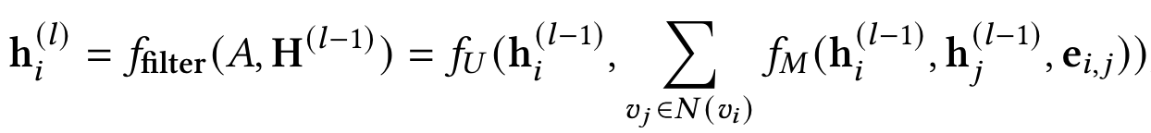
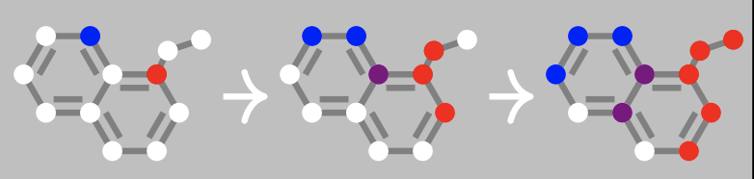
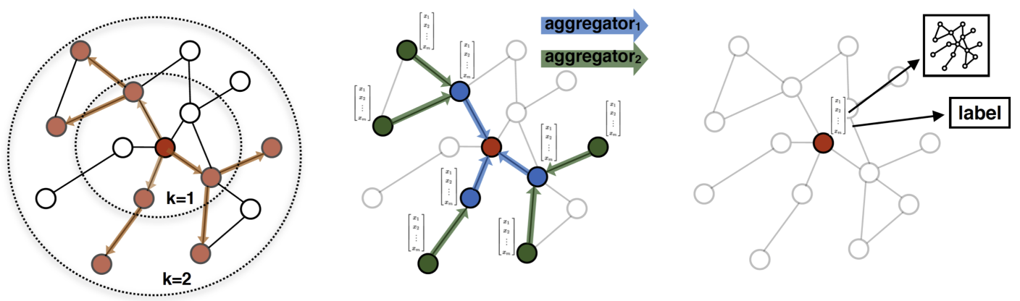
Message Passing Neural Network (MPNN)
Key idea: graph convolutions as a message passing process
MPNN:
expensive if the number of nodes are large
Node and edge embeddings
Update and aggregation functions
GraphSage:
sampling to
obtain a fixed
number of
neighbors
MPNN and GraphSage
in NLP Tasks:
Knowledge graph
Information extraction
Semantic parsing
Node embeddings
Aggregation functions

Slide 26
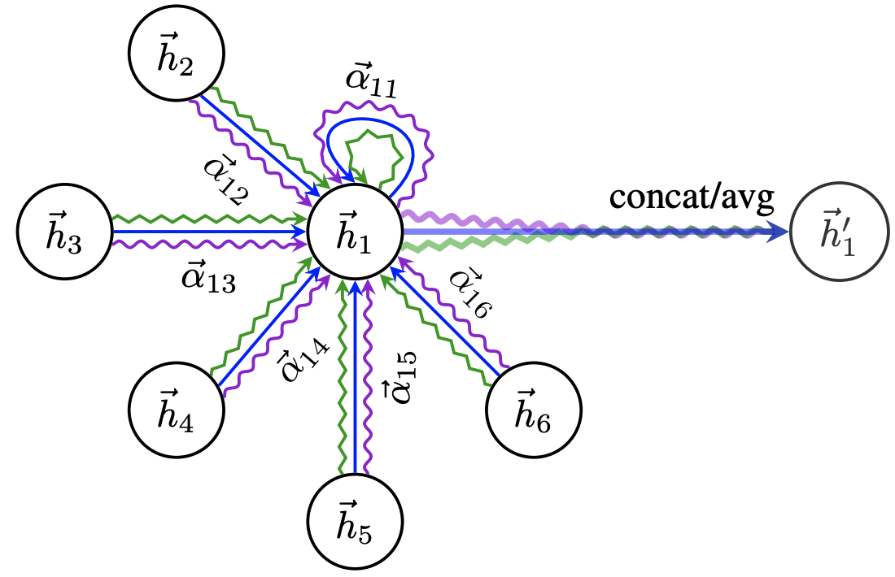
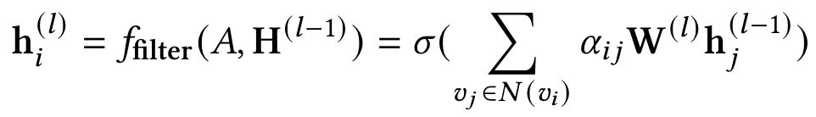
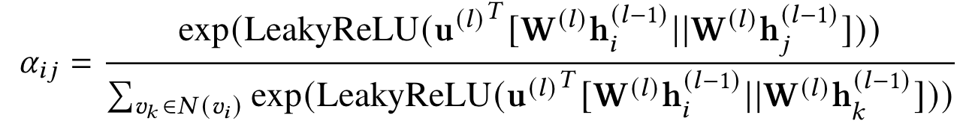
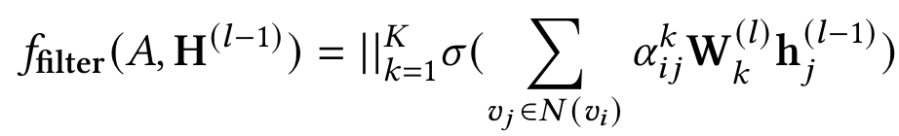
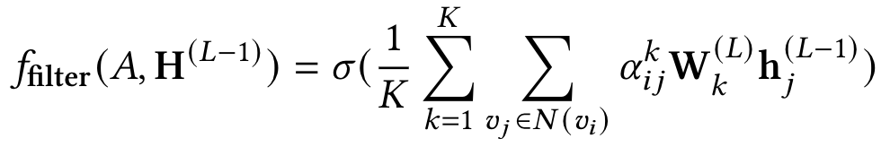
Graph Attention Network (GAT)
Key idea: dynamically learn the weights (attention scores) on the edges when performing message passing
Weighted sum of node embeddings
Learned local weights with self-attention
GAT in NLP Tasks:
Text classification
Question Answering
Knowledge graph
Information extraction
Semantic parsing
Intermediate node embeddings
Final node embeddings

Slide 27
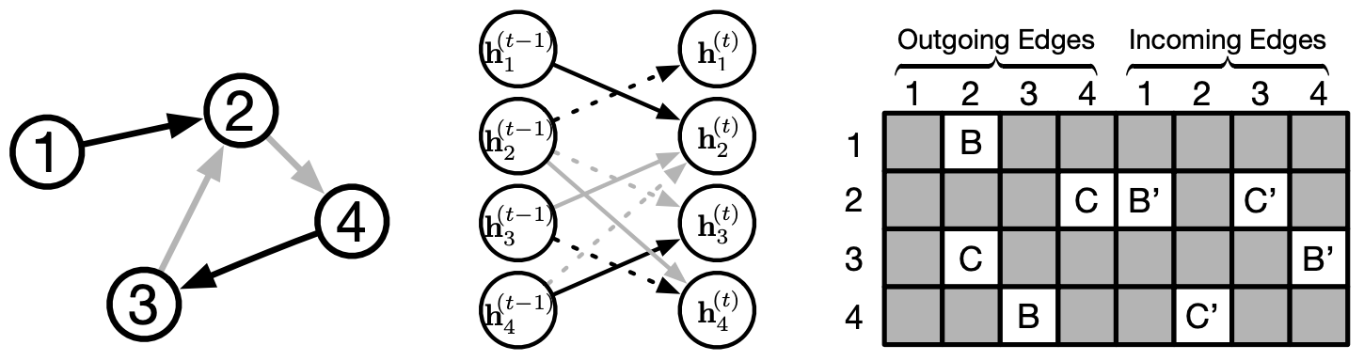
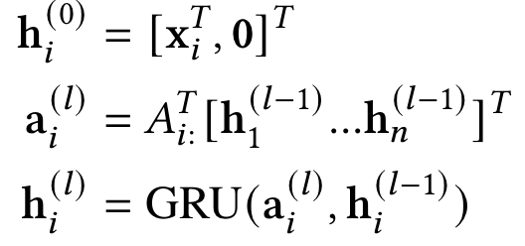
Gated Graph Neural Networks (GGNN)
Key idea: the use of Gated Recurrent Units while taking into account edge type and directions
Zero-padding input node embeddings
Incoming & outcoming edges for node v_{i}
GGNN in NLP Tasks:
Semantic parsing
Machine translation
GRU for fusing node embeddings

Slide 28
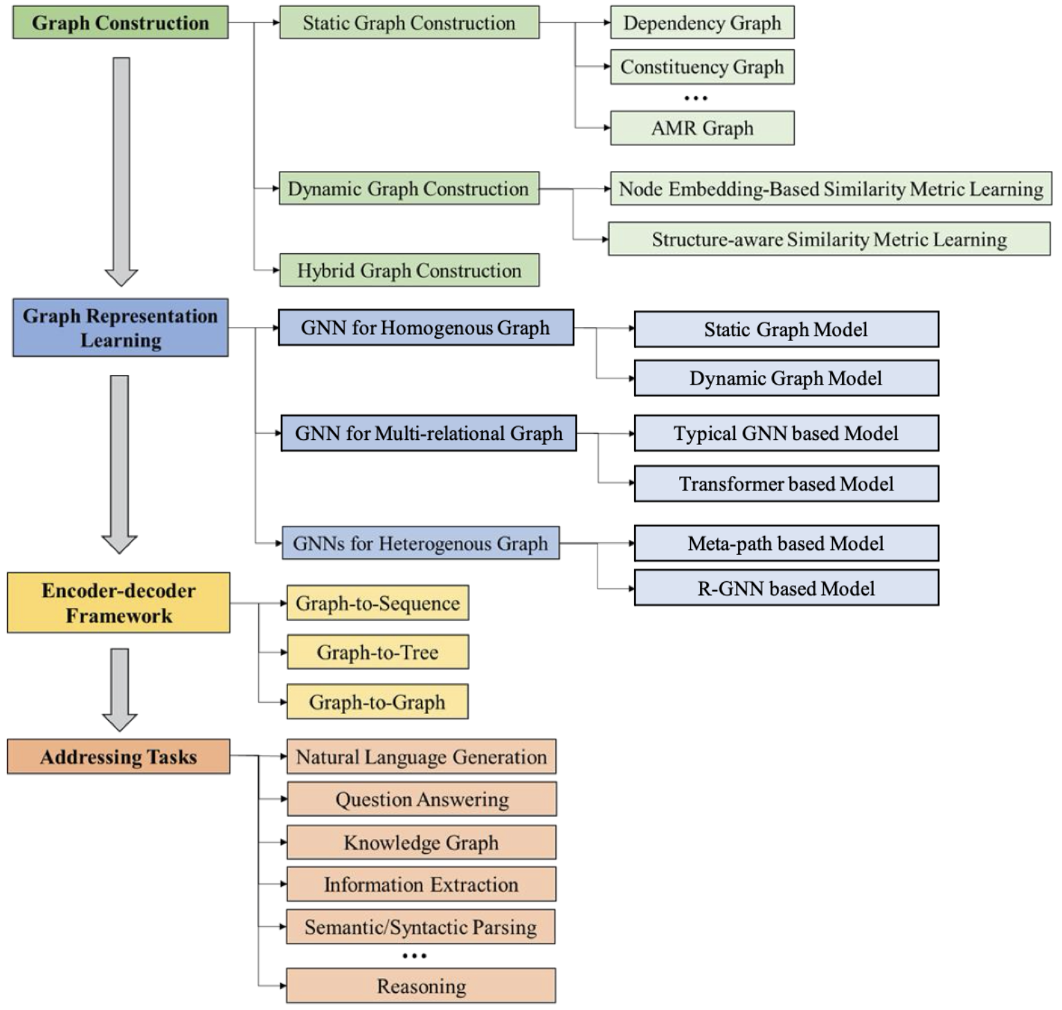
DLG4NLP: A Roadmap
DLG4NLP Key Foundations
DLG4NLP Key Libraries
DLG4NLP Future Directions

Slide 29
DLG4NLP
Foundations

Slide 30
Graph Construction for NLP

Slide 31

Why Graph Construction for NLP?
Representation power: graph > sequence > bag
Different NLP tasks require different aspects of text , e.g., syntax, semantics.
Different graphs capture different aspects of the text
Two categories: static vs dynamic graph construction
Goal: good downstream task performance
Text
GNs
convert to graph
many more graph options…
Notes:
1m
As we previously introduced, there are three typical ways of representing text which are bag, sequence and graph. Among all the three approaches, graph has the strongest representation power because it can capture rich and diverse information about text.
We know that different NLP tasks require different aspects of text such as syntax, semantics. In the meanwhile, different graphs capture different aspects of the text.
(c)Therefore, how to convert text to graph is an important yet challenging question which really depends on what aspects of information we want to capture in a text graph. In general, we group various graph construction approaches into two categories: static graph construction & dynamic graph construction. We will introduce each of them and summarize their properties next.
Note that the primary goal of graph construction we are taking about in this tutorial is to achieve good downstream task performance.

Slide 32
Static Graph Construction
Problem setting:
Input: raw text (e.g., sentence, paragraph, document, corpus)
Output: graph
Conducted during preprocessing by augmenting text with domain knowledge
Notes:
1m
Let’s first talk about static graph construction. It aims to convert the raw text to a graph where text can be a sentence, paragraph, document, corpus and so on.
This is usually conducted during the preprocessing stage by augmenting the raw text with various domain knowledge such as syntax, semantics, topic, co-occurrence and world knowledge.
Many static graph construction approaches used in practice are driven by the particular NLP applications and incorporate hybrid prior knowledge about the data and the task.
Let’s see some representative static graph construction approaches for NLP which are widely used in the existing literature.

Slide 33
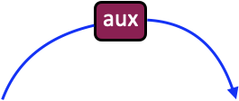
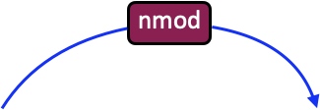
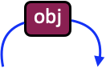
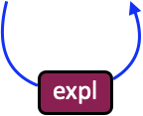
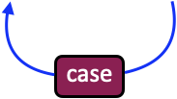
Static Graph Construction: Dependency Graph
Add additional sequential edges to
reserve sequential information in raw text
connect multiple dependency graphs in a paragraph
Dependency parsing
Text input: are there ada jobs outside austin
Notes:
The first static graph construction approach we are going to introduce is dependency graph. dependency parsing aims to assign a tree structure to a sentence which describes a set of directed grammatical relations holding among the words.
It can help extract subject-verb-object triples that are often indicative of semantic relations between predicates, making it directly useful for many NLP applications such as information extraction, semantic parsing, coreference resolution and question answering.
(c)For instance, given a sentence “are there ada jobs outside austin”, one can apply dependency parsing tools to convert it to a graph like this.
(c)But what if we have multiple sentences in text? One common way is to add additional sequential edges between nodes so that we can connect multiple dependency graphs in a paragraph. Besides, it also reserves sequential information in raw text which can be helpful in some applications.

Slide 34
Static Graph Construction: Constituency Graph
S
VP
S
VP
NP
PP
are
there
ada
jobs
outside
austin
Constituency parsing
Again, add additional sequential edges
Text input: are there ada jobs outside austin
Notes:
The next approach we will introduce is constituency graph. The constituency graph is able to capture phrase-based syntactic relations in a sentence.
(c)For instance, given a sentence, one can apply constituency parsing tools to convert it to a graph.
(c)Due to the same reasons, one can add additional sequential edges between nodes.

Slide 35
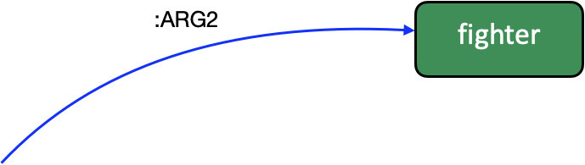



Static Graph Construction: AMR Graph
AMR parsing
Text input: Paul’s description of himself: a fighter
Notes:
The AMR graphs capture various semantic information of the sentences such as semantic roles, within-sentence coreference, named entities and so on. They preserve the semantic meanings of text while abstracting away from syntactic representations, and can help complement the raw text by providing high-level abstract information.
(c)Given a sentence “Paul’s description of himself: a fighter”, one can apply AMR parsing tools to convert it to a graph.

Slide 36





Static Graph Construction: IE Graph
Notes:
The IE graph aims to extract the structural information from text to represent the high-level information about entities and their relations.
(c)Given the input text, one can apply IE tools to convert it to a graph which contains entities such as “Seattle“ as nodes, and relations such as “attended” as edges. Coreference resolution is usually conducted to group entities referring to the same concept to a single node. Like here, Paul, He and a renowned computer scientist refer to the same person.

Slide 37




Static Graph Construction: Knowledge Graph
Notes:
The knowledge graph stores world knowledge about entities and their relations.
(c)Given a question “who acted in the movies directed by the director of Some Mother’s Son?”, one can first identity the topic entity of the question which is “Some Mother’s Son”, and then extract a subgraph from a Knowledge Graph which surrounds the topic entity and hopefully contains the answer entities of this question.

Slide 38



Static Graph Construction: Topic Graph
Notes:
Topic is a subject that text is about. different documents might mention overlapping topics, we can discover the relations among documents by comparing their topics.

Slide 39






Static Graph Construction: Similarity Graph
Notes:
(c)Another way to find the connections among texts is to compute their pair-wise similarity scores.
(c)And one common way to compute similarity scores is to first embed text into some vector representations such as TF-IDF vectors, and then compute pair-wise similarity in the embedding space.

Slide 40



Static Graph Construction: Co-occurrence Graph
Notes:
(c)In order to capture the word co-occurrence information, one can regard the co-occurrence matrix as an adjacency matrix.
(c) And then construct a graph containing each unique word as a node.

Slide 41






Static Graph Construction: SQL Graph
Notes:
Some logic form such as SQL query can also be naturally represented as a
(c)graph which well captures the relations among various objects.

Slide 42

Static Graph Construction: Application-driven Graph
Ming Ding et al. “Cognitive Graph for Multi-Hop Reading Comprehension at Scale”. ACL 2019.
Notes:
So far, we have discussed many common static graph construction approaches which preserve some kind of prior or domain knowledge. In practice, it might be beneficial to construct some hybrid graph capturing multiple sources of prior or domain knowledge which is tightly coupled to the NLP task at hand.

Slide 43
Static Graph Construction: Summary
Widely used in various NLP applications such as NLG, MRC, semantic parsing, etc.
Notes:
As we already see, static graph construction operates by augmenting text with various domain knowledge during preprocessing including syntax, semantics, topic, co-occurrence, world knowledge and so on.
For each type of domain knowledge, there are various types of graphs we can construct.
Which static graph to construct depends on the specific NLP application. For instance, for multi-hop MRC task, entities and entities coreferences across documents are important.
As we will see in the application part of this tutorial, these static graph construction approaches are widely used in various NLP applications such as NLG, reading comprehension and semantic parsing.

Slide 44
Dynamic Graph Construction
Problem setting:
Input: raw text (e.g., sentence, paragraph, document, corpus)
Output: graph
Graph structure (adjacency matrix) learning on the fly, joint with graph representation learning
Notes:
Next, we will introduce dynamic graph construction which shares the same goal with static graph construction. Unlike static graph construction which is performed during preprocessing, dynamic graph construction operates by jointly learning the graph structure and graph representation on the fly. The ultimate goal is to learn the optimized graph structures and representations with respect to certain downstream prediction task.

Slide 45
Dynamic Graph Construction: Overview
Notes:
We summarize the typical dynamic graph construction pipeline as follows.
(c)Given a set of data points which can stand for various NLP elements such as words, sentences and documents, we first apply graph similarity metric learning which aims to capture the pair-wise node similarity and returns a fully-connected weighted graph. Then, we can optionally apply graph sparsification to obtain a sparse graph.
If the input data is instead of data points, but an intrinsic graph containing edges, we can also optionally combine the intrinsic graph and learned implicit graph to form an augmented graph. The output graph will be consumed by a subsequent GNN-based module to learn graph representations and predict outputs.

Slide 46
Dynamic Graph Construction Outline
Notes:
Next, we will introduce each of the four dynamic graph construction techniques which we summarize from the existing practice of its applications in the NLP field. These include graph similarity metric learning techniques, graph sparsification techniques, combining intrinsic graph structures and implicit graph constructions, and learning paradigms.

Slide 47
Graph Similarity Metric Learning Techniques
Graph structure learning as similarity metric learning (in the node embedding space)
Enabling inductive learning
Various metric functions
Notes:
The idea of graph similarity metric learning is to compute the pair-wise node similarity in the node embedding space, and obtain an adjacency matrix based on that.
It can enable inductive learning because once the similarity metric learning is finished, one can apply it to unseen nodes to learn a graph. This is important for many NLP applications, because we want to learn a new graph for each new text example.
Various metric functions have been proposed by previous works. We group them into two categories: node embedding based similarity metric learning and structure-aware similarity metric learning.

Slide 48
Node Embedding Based Similarity Metric Learning
Learning a weighted adjacency matrix by computing the pair-wise node similarity in the embedding space
Common metrics functions
Attention-based similarity metric functions
Cosine-based similarity metric functions
Notes:
For node embedding based similarity metric learning,
(c)we are given a set of data points and their vector representations, and apply various metric functions to learn pair-wise node similarity. The output is a weighted adjacency matrix which is corresponding to a fully-connected weighted graph.
(c)Common metric functions include attention-based and cosine-based functions.

Slide 49
Attention-based Similarity Metric Functions
Variant 1)
Node feature vector
Non-negative learnable weight vector
Variant 2)
Learnable weight matrix
Chen at al. “GraphFlow: Exploiting Conversation Flow with Graph Neural Networks for Conversational Machine Comprehension”. IJCAI 2020.
Chen et al. “Reinforcement Learning Based Graph-to-Sequence Model for Natural Question Generation”. ICLR 2020.
Notes:
Let’s talk about attention-based …
In variant 1), v_i is node embedding, and u is a non-negative weight vector learning to highlight different dimensions of the node embeddings.
In variant 2), W is learnable weight matrix which maps the node embedding to a latent space, ReLU is used to enforce the sparsity of the similarity matrix.
In both variants, dot product is used to compute similarity.
S_{i,j} = (\mathbf{v}_i \odot \mathbf{u})^T \mathbf{v}_j
u is a non-negative weight vector learning to highlight different dimensions of the node embeddings
S_{i,j} = \mathrm{ReLU}(\mathbf{W} \mathbf{v}_i)^T \mathrm{ReLU}(\mathbf{W} \mathbf{v}_j)
ReLU used to enforce the sparsity of the similarity matrix.

Slide 50
Cosine-based Similarity Metric Functions
Learnable weight vector
Multi-head similarity scores
Chen et al. “Iterative Deep Graph Learning for Graph Neural Networks: Better and Robust Node Embeddings”. NeurIPS 2021.
Notes:
Let’s see an example of cosine-based metric function.
(c)Here, w_p is a weight vector associated to the p-th perspective, and has the same dimension as the node embeddings. Intuitively, S_{i,j}^p computes the pair-wise cosine similarity for the p-th perspective where each perspective considers one part of the semantics captured in the embeddings.
(c)One can average multi-head similarity scores to increase the learning power of the metric, which is similar to the idea of multi-head attention in Transformer.
S_{i,j}^p &= \mathrm{cos}(\mathbf{w}_p \odot \mathbf{v}_i, \mathbf{w}_p \odot \mathbf{v}_j)
S_{i,j} &= \frac{1}{m}\sum_{p=1}^{m}{S_{ij}^p}

Slide 51
Structure-aware Similarity Metric Learning
Learning a weighted adjacency matrix by computing the pair-wise node similarity in the embedding space
Considering existing edge information of the intrinsic graph in addition to the node information
Notes:
Now, let’s talk about structure-aware similarity metric learning. Unlike the node embedding based metric learning,
(c)this metric learning approach in addition considers the existing edge information of the intrinsic graph when it’s available.
S_{i, j}^l = \mathrm{softmax}(\mathbf{u}^T \mathrm{tanh}(\mathbf{W}[\mathbf{h}^l_i, \mathbf{h}^l_j, \mathbf{v}_i, \mathbf{v}_j, \mathbf{e}_{i,j}]))
https://arxiv.org/abs/1811.08600
S_{i, j} = \frac{\mathrm{ReLU}(\mathbf{W}^Q \mathbf{v}_i )^T (\mathrm{ReLU}( \mathbf{W}^K \mathbf{v}_i)+ \mathrm{ReLU}(\mathbf{W}^R \mathbf{e}_{i, j}))}{\sqrt{d}}

Slide 52
Attention-based Similarity Metric Functions
Variant 1)
Edge embeddings
Variant 2)
Liu et al. “Contextualized Non-local Neural Networks for Sequence Learning”. AAAI 2019.
Liu et al. “Retrieval-Augmented Generation for Code Summarization via Hybrid GNN”. ICLR 2021.
Notes:
Let’s see two example metric functions.
(c)In these two variants, attention-based function is applied and notably, edge embeddings of the intrinsic graph play an important role in learning the implicit graph structure.
S_{i, j}^l = \mathrm{softmax}(\mathbf{u}^T \mathrm{tanh}(\mathbf{W}[\mathbf{h}^l_i, \mathbf{h}^l_j, \mathbf{v}_i, \mathbf{v}_j, \mathbf{e}_{i,j}]))
https://arxiv.org/abs/1811.08600
S_{i, j} = \frac{\mathrm{ReLU}(\mathbf{W}^Q \mathbf{v}_i )^T (\mathrm{ReLU}( \mathbf{W}^K \mathbf{v}_i)+ \mathrm{ReLU}(\mathbf{W}^R \mathbf{e}_{i, j}))}{\sqrt{d}}

Slide 53
Graph Sparsification Techniques
Similarity metric functions learn a fully-connected graph
Fully-connected graph is computationally expensive and might introduce noise
Enforcing sparsity to the learned graph structure
Various techniques
Notes:
So far, similarity metric functions learn a fully-connected graph. However,
(c)fully-connected graph is computationally expensive and might introduce noise.avoid oversmooth
(c)We might want to enforce sparsity to the learned graph structure to obtain a sparse graph by
(c)leveraging various techniques such as what we list as follows.

Slide 54
Common Graph Sparsification Options
Option 1) KNN-style Sparsification
Option 2) epsilon-neighborhood Sparsification
Option 3) graph Regularization
Notes:
(c)For KNN-style sparsification, for each node, only the $K$ nearest neighbors (including itself) and the associated similarity scores are kept, and the remaining similarity scores are masked off.
(c)For epsilon-neighborhood sparsification, those elements in $S$ which are smaller than a non-negative threshold $\varepsilon$ are all masked off
(c)Besides explicitly enforcing the sparsity of the learned graph by applying certain form of threshold, sparsity can also be enforced implicitly in a learning-based manner. For example, we can apply certain form of graph regularization to the learned adjacency matrix.
\mathbf{A}_{i,:} = \mathrm{topk}(\mathbf{S}_{i,:})
\cite{chen2020reinforcement,chen2020graphflow}
A_{i,j} =
\left\{
\begin{array}{ll}
S_{i,j} & \quad S_{i,j} > \varepsilon \\
0 & \quad \text{otherwise}
\end{array}
\right.
chen2020iterative
\frac{1}{n^2} ||A||_F^2
chen2020iterative

Slide 55
Combining Intrinsic and Implicit Graph Structures
Intrinsic graph typically still carries rich and useful information
Learned implicit graph is potentially a “shift” (e.g., substructures) from the intrinsic graph structure
Normalized graph Laplacian
f(A) can be arbitrary operation, e.g., graph Laplacian, row-normalization
Li et al. “Adaptive Graph Convolutional Neural Networks”. AAAI 2018.
Chen et al. “Iterative Deep Graph Learning for Graph Neural Networks: Better and Robust Node Embeddings”. NeurIPS 2021.
Notes:
the intrinsic graph typically still carries rich and useful information regarding the optimal graph structure for the downstream task.
(c)Some recent works proposed to combine the learned implicit graph structure with the intrinsic graph structure based on the assumption that the learned implicit graph is potentially a ``shift‘’ (e.g., substructures) from the intrinsic graph structure which is supplementary to the intrinsic graph structure.
(c)One common way to do this is to compute a linear combination of the normalized graph Laplacian of the intrinsic graph structure and the normalized adjacency matrix of the implicit graph structure. And we can apply various normalization operations to the learned adjacency matrix such as graph Laplacian, row-normalization, etc.
\widetilde{A} = \lambda L^{(0)} + (1 - \lambda) \mathrm{f}(A)
li2018adaptive,chen2020iterative

Slide 56
Learning Paradigms: Joint Learning
Node features & (optional) initial graph structure
Downstream task prediction
Learned graph structure
Graph Learner
GNN
Chen at al. “GraphFlow: Exploiting Conversation Flow with Graph Neural Networks for Conversational Machine Comprehension”. IJCAI 2020.
Chen et al. “Reinforcement Learning Based Graph-to-Sequence Model for Natural Question Generation”. ICLR 2020.
Liu et al. “Contextualized Non-local Neural Networks for Sequence Learning”. AAAI 2019.
Liu et al. “Retrieval-Augmented Generation for Code Summarization via Hybrid GNN”. ICLR 2021.
Notes:
Now, let’s talk about some important learning paradigms for dynamic graph constructions which have been explored so far. Most existing dynamic graph construction approaches for GNNs consist of two key learning components: graph structure learning and graph representation learning.
(c)The most straightforward strategy is to jointly optimize the whole learning system in an end-to-end manner toward the downstream downstream prediction task.

Slide 57
Learning Paradigms: Adaptive Learning
Node features & (optional) initial graph structure
Downstream task prediction
Learned graph structure 1
Node embeddings 1
Learned graph structure N
Graph Learner1
GNN
Layer1
Graph LearnerN
GNN
LayerN
Repeat for fixed num. of stacked GNN layers
Li et al. “Adaptive Graph Convolutional Neural Networks”. AAAI 2018.
Notes:
(c)Another common strategy is to adaptively learn the input graph structure to each stacked GNN layer to reflect the changes of the intermediate graph representations. This is kind of similar to how transformer models learn different weighted fully-connected graphs in each layer.

Slide 58
Learning Paradigms: Iterative Learning
Node features & (optional) initial graph structure
Downstream task prediction
Learned graph structure
Graph Learner
GNN
Node embeddings
Repeat until condition satisfied
Chen et al. “Iterative Deep Graph Learning for Graph Neural Networks: Better and Robust Node Embeddings”. NeurIPS 2021.
Notes:
Unlike the above two paradigms,
(c)recent work proposed an iterative graph learning framework by learning a better graph structure based on better graph representations,
(c)and in the meantime, learning better graph representations based on a better graph structure in an iterative manner.
(c)As a result, this iterative learning paradigm repeatedly refines the graph structure and the graph representations toward the optimal downstream performance.
Various stopping conditions can be applied for the iterative learning process. For example, one can stop the iterative process when the difference between learned adj matrix at consecutive iterations is small enough.

Slide 59
Dynamic Graph Construction Summary
Notes:
So far, we have introduced various dynamic graph construction techniques
(c)including grahp similarity meteric learning, graph sparsification, combining intrinsic and implicit grahp structures and learning paradigms.

Slide 60
Static vs. Dynamic Graph Construction
New topic in DLG4NLP!
Static graph construction | Dynamic graph construction
Pros | Pros
prior knowledge | no domain expertise
 | joint graph structure & representation learning
Cons | Cons
extensive domain expertise | scalability
error-prone (e.g., noisy, incomplete) sub-optimal | explainability
disjoint graph structure & representation learning error accumulation
Notes:
Why might ask “how is static graph construction compared with dynamic graph construction, which is better?”
Let’s first talk about static graph construction, the biggest advantage is it can easily encode rich prior knowledge in graph which can be very helpful for certain NLP applications. But this can also become a downside when it’s expensive or not doable to obtain such extensive domain expertise. For example, for some low-resource languages, we might not have rich prior knowledge to utilize. Besides, static graph construction is error-prone due to noisy or incomplete graph and therefore is often sub-optimal. Due to its disjoint graph construction & representation learning nature, it can also lead to error accumulation.
Compared to static graph construction, dynamic graph construction
(c)is quite new and has not been extensively studied in the DLG4NLP area. It’s advantages include requiring no domain expertise, and joint learning of graph structures and representations. Currently, it has some obvious disadvantages such as scalability and explainability which are actually good future directions in this topic.

Slide 61




Static vs. Dynamic Graph Construction (cont)
When to use static graph construction
Domain knowledge which fits the task and can be presented as a graph
When to use dynamic graph construction
Lack of domain knowledge which fits the task or can be presented as a graph
Domain knowledge is incomplete or might contain noise
To learn implicit graph which augments the static graph
Dynamic graph
Liu et al. “Retrieval-Augmented Generation for Code Summarization via Hybrid GNN”. ICLR 2021.
61
Notes:
Now it comes to the question, “when to use which”.
(c)Based on our study and practice, it’s best to use static graph construction when we have domain knowledge at hand which fits the task and can be presented as a graph.
(c)For dynamic graph construction, here might be some reasons why we want to look into that, including 1), 2), 3)
Actually, we think the last point is the big advantage of dynamic graph construction since we can combine the benefits of both intrinsic static graph and dynamically learned implicit graph.

Slide 62
Graph Representation Learning for NLP

Slide 63
GNNs for Graph Representation Learning
Graph Construction
Graph Representation Learning
Prediction
Notes:
Let’s briefly recap on the DLG4NLP pipeline. Given a graph, we will need to decide which GNNs to apply for graph representation learning. We will try to help answer this question in this part.

Slide 64
Homogeneous vs Multi-relational vs Heterogeneous Graphs
Graph types | Homogeneous | Multi-relational | Heterogeneous
# of node types | 1 | 1 | > 1
# of edge types | 1 | > 1 | >= 1
Notes:
Let’s first review some definitions on various types of graphs. These concepts are important since we will mainly depend on graph types to choose which GNNs to apply.

Slide 65
Which GNNs to Use Given a Graph?
Homogeneous GNNs
Multi-relational GNNs
Heterogeneous GNNs
Notes:
Let’s first see the overall roadmap on which GNNs to use given a graph. This works like a decision tree which we summarized to help you make this decision. In short, we will decide whether to apply homogeneous GNNs, multi-relational GNNs or heterogeneous GNNs based on the input graph types.

Slide 66
Homogeneous GNNs for NLP
When to use homogeneous GNNs?
Homogeneous GNNs
GCN
GAT
GraphSAGE
GGNN
…
Notes:
When to use homogeneous GNNs?
(c)Given a graph, …
(c)homogeneous GNNs include many of the GNN variants which we have introduced in the introduction part.

Slide 67
Non-homogeneous to Homogeneous Conversion via Levi Graph
fighter
:ARG2
describe-01
:ARG1
person
:ARG0
name
:name
“Paul”
:op1
Levi graph conversion
Levi graph: edges as new nodes
Notes:
Given a non-homogeneous graph which contains various edge types, we can legerage
(c)levi graph conversion to …. Then we can simply apply homogeneous GNNs.
(c) The key dea is to regard each edge in the original graph as new nodes, and connect original nodes and new nodes. As a result, we will get a bipartite graph.

Slide 68
How to Handle Edge Direction Information?
Edge direction is important (think about BiLSTM, BERT)
Common strategies for handling directed graphs
Message passing only along directed edges (e.g., GAT, GGNN)
Regarding edge directions as edge types (i.e., adding “reverse” edges)
Bidirectional GNNs
b)
a)
c)
Notes:
We know edge direction is important (think about the success of BiLSTM and BERT). Given a directed graph, we might not able to directly apply some homogeneous GNNs which will lead to edge direction information loss.
(c)Common strategies for handling directed graphs include a), b), c)
We will introduce each of them next.

Slide 69
Edge Directions as Edge Types
Regarding edge directions as edge types, resulting in a multi-relational graph
Then we can apply multi-relational GNNs
Notes:
dir_{i, j}=\left\{
\begin{aligned}
&default, & \mbox{$e_{i, j}$ is originally existing in the graph} \\
&inverse, & \mbox{$e_{i, j}$ is the inverse edge} \\
&self, & i = j
\end{aligned}
\right.

Slide 70


Bidirectional GNNs for Directed Graphs
Bi-Sep GNNs formulation:
Run multi-hop backward/forward GNN on the graph
Concatenate backward/forward node embeddings at last hop
Xu et al. “Graph2Seq: Graph to Sequence Learning with Attention-based Neural Networks”. 2018.
Notes:
We summarized two varaints of Bidirectional GNNs. The first one is called Bi-Sep GNN.
(c)Bi-sep works similarly to the famous BiLSTM mode, 1), 2)
\mathbf{h}^{k}_{i, \dashv} &= \textit{GNN}(\mathbf{h}^{k-1}_{i, \dashv}, \{\mathbf{h}^{k-1}_{j, \dashv}: \forall v_j \in \mathcal{N}_{\dashv}(v_i) \})
\mathbf{h}^{k}_{i, \vdash} &= \textit{GNN}(\mathbf{h}^{k-1}_{i, \vdash}, \{\mathbf{h}^{k-1}_{j, \vdash}: \forall v_j \in \mathcal{N}_{\vdash}(v_i) \})
\mathbf{h}^{K}_{i} = \mathbf{h}^{K}_{i, \dashv} || \mathbf{h}^{K}_{i, \vdash}

Slide 71
Bidirectional GNNs for Directed Graphs (cont)
Bi-Fuse GNNs formulation:
Run one-hop backward/forward node aggregation
Fuse backward/forward aggregation vectors at each hop
Update node embeddings with fused aggregation vectors at each hop
Chen et al. “Reinforcement Learning Based Graph-to-Sequence Model for Natural Question Generation”. ICLR 2020.
Notes:
The second one we will introduce is called Bi-Fuse GNN.
(c) 1), 2), 3)
\mathbf{h}^{k}_{\mathcal{N}_{\dashv}(v_i)} &= \textit{AGG}(\mathbf{h}^{k-1}_i, \{\mathbf{h}^{k-1}_j: \forall v_j \in \mathcal{N}_{\dashv}(v_i) \})
\mathbf{h}^{k}_{\mathcal{N}_{\vdash}(v_i)} &= \textit{AGG}(\mathbf{h}^{k-1}_i, \{\mathbf{h}^{k-1}_j: \forall v_j \in \mathcal{N}_{\vdash}(v_i) \})
\mathbf{h}^k_{\mathcal{N}(v_i)} = \textit{Fuse}(\mathbf{h}^{k}_{\mathcal{N}_{\dashv}(v_i)}, bi_fuse)
\mathbf{h}^{k}_i = \sigma(\mathbf{h}^{k-1}_i, \mathbf{h}^k_{\mathcal{N}(v_i)})

Slide 72
Multi-relational GNNs for NLP
When to use multi-relational GNNs?
Multi-relational GNNs
Including relation-specific transformation parameters in GNN
Including edge embeddings in GNN
Multi-relational Graph Transformers
Notes:
When to use multi-relational GNNs?
(c)Given a graph, …
(c)multi-relational GNNs have various types of architectures. We sumarized three common variants which either a), b), c)

Slide 73
R-GNN: Overview
GNN
1) relation-specific transformation,
e.g., node feature transformation,
attention weight …
R-GNN
2) aggregation per relation-specific subgraph
Notes:
R-GNN is the most common variant which works like this.(c)
It has two features, 1), 2)
Introduce equation
\mathbf{h}^{k}_i = \sigma(\mathbf{h}^{k-1}_{i}, \sum_{v_j \in \mathcal{N}(v_i)} \textit{AGG}(\mathbf{h}^{k-1}_{j}, \mathbf{\theta}^{k}))
\mathbf{h}^{k}_i = \sigma(\mathbf{h}^{k-1}_{i}, \sum_{r \in \mathcal{E}} \sum_{v_j \in \mathcal{N}_{r}(v_i)} \textit{AGG}(\mathbf{h}^{k-1}_{j}, \mathbf{\theta}^{k}_{r}))
Key idea: apply relation-specific node feature transformation

Slide 74
R-GNN Variant: R-GCN
Relation-specific node feature transformation during neighborhood aggregation
Relation-specific d x d learnable weight matrix
Schlichtkrull et al. “Modeling Relational Data with Graph Convolutional Networks”. 2017.
Notes:
When we apply the R-GNN idea to GCN, we get R-GCN.
(c) Introduce equation
\mathbf{h}^{k}_i = \sigma(\sum_{r \in \mathcal{E}} \sum_{v_j \in \mathcal{N}_{r}(v_i)} {\frac{1}{c_{i, r}} {\mathbf{W}^{k}_{r} \mathbf{h}^{k-1}_{j}} } + \mathbf{W}^{k}_{0}\mathbf{h}^{k-1}_{i}), \quad c_{i, r} = |\mathcal{N}_{r}(v_i)|

Slide 75
R-GNN: Avoiding Over-parameterization
Learning d x d transformation weight matrix for each relation is expensive!
O(Rd^2) parameters every GNN layer where R is the num of relation types
How to avoid over-parameterization?
Option 1) basis decomposition
- linear hypothesis
O(RB + Bd^2) parameters
Basis matrices
Option 2) block-diagonal decomposition
- sparsity hypothesis
O(Rd^2/B) parameters
Submatrices
Notes:
R-GNN is good at doing relation-specic message passing and hence handle multi-relational graph. However, expensive…
There are two common ways. One is to
(c)introduce basis decomposition, which regards the relation matrices as the linear combination of shared basis, which can be seen as a form of weight sharing between different relations.
(c)The second strategy is block-diagonal decomposition which can be seen as a matrix sparsity constraint.
Both of the two regularization methods aim to decrease the number of parameters, further alleviating the overfitting problem. The first strategy in eq. \ref{eq:basis} actually regard the relation matrices as the linear combination of shared basis, which can be seen as a form of weight sharing between different relations. The second strategy can be seen as a matrix sparsity constraint. It holds the hypothesis that the latent features can be represented by sets of variables that are more tightly coupled within groups than across groups.
\mathbf{\theta}_{r}^{k} = \sum_{b=1}^{B}a_{rb}^{k}\mathbf{V}_{b}^{k}, \quad \mathbf{V}_{b}^{(k)} \in \mathbb{R}^{d \times d}
\mathbf{\theta}_{r}^{k} = \bigoplus_{b=1}^{B}\mathbf{Q}_{br}^{k}=\textit{diag}(\mathbf{Q}_{1r}^k, \mathbf{Q}_{2r}^k, ..., \mathbf{Q}_{Br}^k), \quad \mathbf{Q}_{br}^{(k)} \in \mathbb{R}^{d/B \times d/B}

Slide 76
Including Edge Embeddings in GNNs
Variant 1) Include edge embeddings in message passing
Edge embeddings
Variant 2) Update edge embedding in message passing
Update edge embeddings
Chen et al. “Toward Subgraph Guided Knowledge Graph Question Generation with Graph Neural Networks”. 2020.
Vashishth et al. “Composition-based Multi-Relational Graph Convolutional Networks”. ICLR 2020.
Notes:
The second type of multi-relational GNN explicitly includes edge emb in GNNs.
(c) In both variants e_ij participate into the node aggregation process.
(c) Compared to varaint 1), variant 2) updates e_ij
\mathbf{h}^{k}_i = \sigma(\mathbf{h}^{k-1}_{i}, \sum_{v_j \in \mathcal{N}(v_i)} \textit{AGG}(\mathbf{h}^{k-1}_{j}, \mathbf{e}_{i,j}, \mathbf{\theta}^{k}))
\mathbf{h}^{k}_i = \sigma(\mathbf{h}^{k-1}_{i}, \sum_{v_j \in \mathcal{N}(v_i)} \textit{AGG}(\mathbf{h}^{k-1}_{j}, \mathbf{e}_{i,j}^{k-1}, \mathbf{\theta}^{k})), \quad \mathbf{e}_{i,j}^{k}=\textit{f}(\mathbf{e}_{i,j}^{k-1}, \theta^k_{rel})
KGQG paper, competitive results with much fewer num of parameters
Comp-GCN paper: https://arxiv.org/pdf/1911.03082.pdf

Slide 77
Multi-relational Graph Transformers
Transformers as a special class of GNNs which
jointly learn and encode a fully-connected graph via self-attention
share many similarities with GAT
fail to effectively handle arbitrary graph-structured data
e.g., position embeddings for sequential data, removing position embeddings for set
Multi-relational graph transformers
employed with structure-aware self-attention
respect various relation types
Notes:
Transformers can be regarded as a special class of GNNs where multi-head self-attention is learning dynamic graph structures adaptively at each layer.
Read …
The last type of multi-relational GNN is multi-relational graph transformer which combines features from typical GNNs and transformer architectures.
(c)They usually …

Slide 78

R-GAT based Graph Transformers
GAT-like masked attention
Relation-specific learnable weight matrix
Yao et al. “Heterogeneous Graph Transformer for Graph-to-Sequence Learning”. ACL 2020.
Notes:
R-GAT based graph transformer
c) GAT-like mask attention which respects the graph structure of the input data
C0 relation-specific learnable weight matrix which respects the edge type information
\mathbf{z}_i^{r,k} &= \sum_{v_j \in \mathcal{N}_{r}(v_i)} \alpha_{i, j}^k \mathbf{W}^k \mathbf{h}_{j}^{k-1}, r \in \mathcal{E}\\
\mathbf{h}^{k}_i &= \text{FFN}^{k}(\mathbf{W}^{O} [\mathbf{z}_i^{R_1, k},...,\mathbf{z}_i^{R_m, k}])

Slide 79

Structure-aware Self-attention based Graph Transformers
Edge embeddings
Xiao et al. “Lattice-Based Transformer Encoder for Neural Machine Translation”. ACL 2019.
Zhu et al. “Modeling Graph Structure in Transformer for Better AMR-to-Text Generation”. EMNLP 2019.
Notes:
Structure-aware self-attention based graph transformers
c) Edge embeddings participate into both the self-attention computation and node aggregation process.
\mathbf{h}_i^{k} &= \sum_{j} \alpha_{i, j}^k (\mathbf{W}_V^{k} \mathbf{h}_{j}^{k-1} + \mathbf{W}_F^{k}\mathbf{e}_{i,j})\\
\alpha_{i, j}^k &= \textit{softmax}(u_{i, j}^k)\\
u_{i, j}^k &= \frac{ (\mathbf{W}_Q^{k} \mathbf{h}^{k-1}_{i})^T (\mathbf{W}_K^{k} \mathbf{h}^{k-1}_{j} + \mathbf{W}_R^{k}\mathbf{e}_{i, j}) }{\sqrt{d}}\\
https://arxiv.org/pdf/1906.01282.pdf
https://arxiv.org/pdf/1909.00136.pdf

Slide 80

Heterogeneous GNNs
When to use Heterogeneous GNNs?
Heterogeneous GNNs
Meta-path based Heterogeneous GNNs
Meta paths among author nodes
Notes:
When to use Heterogeneous GNNs?
(c)Given a graph,
(c)We will introduce one popular variant of heterogeneous GNNs which is based on the meta-path idea.
(c)Here is an example of meta path. Given an author-author node type pair, we can extra at least two meta paths between them.
Meta-path image from https://www.researchgate.net/publication/329956636_Joint_Embedding_of_Meta-Path_and_Meta-Graph_for_Heterogeneous_Information_Networks

Slide 81
Meta-path based Heterogeneous GNN example: HAN
Step 1) type-specific node feature transformation
Node-type specific learnable weight matrix
Step 2) node-level aggregation along each meta path
Aggregate over neighboring nodes in k-length meta path
Step 3) meta-path level aggregation
Attention weights over meta paths
Wang et al. “Heterogeneous Graph Neural Networks for Extractive Document Summarization”. ACL 2020.
Notes:
Below are the three key steps of meta-path based heterogeneous GNN,
(c)1), 2), 3)
\mathbf{h}_{i} = \mathbf{W}_{\tau({v_i})} \mathbf{v}_{i}
\mathbf{z}_{i, \Phi_k} &= \sigma(\sum_{v_j \in \mathcal{N}_{\Phi_k}(v_i)} \alpha^{\Phi_k}_{i, j} \mathbf{h}_{j})\\
\alpha^{\Phi_k}_{i, j} &= softmax_j(u^{\Phi_{k}}_{i, j}) \\
u^{\Phi_k}_{i, j} &= \sigma(\mathbf{W}[\mathbf{h}_{i},\mathbf{h}_{j}])
\mathbf{z}_{i} = \sum_{k=1}^{p} \beta_{\Phi_k} \mathbf{z}_{i, \Phi_k}
(\beta_{\Phi_1}, ..., \beta_{\Phi_p}) = \text{Meta\_Attn}(\mathbf{Z}_{\Phi_1}, ..., \mathbf{Z}_{\Phi_p})

Slide 82
Graph Encoder-Decoder Models
for NLP

Slide 83

Seq2Seq: Applications and Challenges
Applications
Machine translation
Natural language generation
Logic form translation
Information extraction
Challenges
Only applied to problems whose inputs are represented as sequences
Cannot handle more complex structure such as graphs
Converting graph inputs into sequences inputs lose information
Augmenting original sequence inputs with additional structural information enhances word sequence feature

Slide 84
Graph-to-Sequence Model
Graph Convolutional Neural Network
[1] Kun Xu*, Lingfei Wu*, Zhiguo Wang, Yansong Feng, Michael Witbrock, and Vadim Sheinin (Equally Contributed), "Graph2Seq: Graph to Sequence Learning with Attention-based Neural Networks", arXiv 2018.
[2] Yu Chen, Lingfei Wu** and Mohammed J. Zaki (**Corresponding Author), "Reinforcement Learning Based Graph-to-Sequence Model for Natural Question Generation”, ICLR’20.

Slide 85
Bidirectional GNNs for Directed Graphs
Bi-Sep GNNs formulation:
Run multi-hop backward/forward GNN on the graph
Concatenate backward/forward node embeddings at last hop
Xu et al. “Graph2Seq: Graph to Sequence Learning with Attention-based Neural Networks”. 2018.
Notes:
\mathbf{h}^{k}_{i, \dashv} &= \textit{GNN}(\mathbf{h}^{k-1}_{i, \dashv}, \{\mathbf{h}^{k-1}_{j, \dashv}: \forall v_j \in \mathcal{N}_{\dashv}(v_i) \})
\mathbf{h}^{k}_{i, \vdash} &= \textit{GNN}(\mathbf{h}^{k-1}_{i, \vdash}, \{\mathbf{h}^{k-1}_{j, \vdash}: \forall v_j \in \mathcal{N}_{\vdash}(v_i) \})
\mathbf{h}^{K}_{i} = \mathbf{h}^{K}_{i, \dashv} || \mathbf{h}^{K}_{i, \vdash}

Slide 86
Bidirectional GNNs for Directed Graphs (cont)
Bi-Fuse GNNs formulation:
Run one-hop backward/forward node aggregation
Fuse backward/forward aggregation vectors at each hop
Update node embeddings with fused aggregation vectors at each hop
Chen et al. “Reinforcement Learning Based Graph-to-Sequence Model for Natural Question Generation”. ICLR 2020.
Notes:
\mathbf{h}^{k}_{\mathcal{N}_{\dashv}(v_i)} &= \textit{AGG}(\mathbf{h}^{k-1}_i, \{\mathbf{h}^{k-1}_j: \forall v_j \in \mathcal{N}_{\dashv}(v_i) \})
\mathbf{h}^{k}_{\mathcal{N}_{\vdash}(v_i)} &= \textit{AGG}(\mathbf{h}^{k-1}_i, \{\mathbf{h}^{k-1}_j: \forall v_j \in \mathcal{N}_{\vdash}(v_i) \})
\mathbf{h}^k_{\mathcal{N}(v_i)} = \textit{Fuse}(\mathbf{h}^{k}_{\mathcal{N}_{\dashv}(v_i)}, bi_fuse)
\mathbf{h}^{k}_i = \sigma(\mathbf{h}^{k-1}_i, \mathbf{h}^k_{\mathcal{N}(v_i)})

Slide 87

Graph Encoding
Graph embedding
Pooling based graph embedding (max, min and average pooling)
Node based graph embedding
Add one super node which is connected to all other nodes in the graph
The embedding of this super node is treated as graph embedding

Slide 88

Attention Based Sequence Decoding
context vector
node representation

Slide 89
Attention Based Sequence Decoding
context vector
node representation
attention weights
alignment model

Slide 90

Attention Based Sequence Decoding
context vector
node representation
attention weights
alignment model
Objective Function

Slide 91


Text Reasoning and Shortest Path
Notes:
Experiments: Text Reasoning and Shortest Path

Slide 92

Effect of Bidirectional Node Embedding
Converge
More quickly
Bidirectional Node Embedding
VS Unidirectional Node Embedding

Slide 93


When Shall We Use Graph2Seq?
Case I: the inputs are naturally or best represented in graph
Case II: Hybrid Graph with sequence and its hidden structural information
Augmenting “are there ada jobs outside Austin”
with its dependency parsing tree results
“Ryan’s description of himself: a genius.”

Slide 94

Learning Structured Input-Output Translation
To bridge the semantic gap between the human-readable words and machine-understandable logics.
Semantic parsing is important for question answering, text understanding
Automatically solving of MWP is a growing interest.

Slide 95



Graph and Tree Constructions

Slide 96


Tree Decoding
DFS-based tree decoder
BFS-based tree decoder
Notes:
Depth First Search based tree decoder
Breadth First Search based tree decoder

Slide 97

Graph-to-Tree Model
[1] Shucheng Li*, Lingfei Wu*, et al. "Graph-to-Tree Neural Networks for Learning Structured Input-Output Translation with Applications to Semantic Parsing and Math Word Problem", EMNLP 2020.

Slide 98



Separated Attention Based Tree Decoding
Context vector embeddings
Separated attention weights
Final attention hidden state

Slide 99


Math Word Problem

Slide 100

Visualization of Separated Attentions

Slide 101
10 Minutes Break
Want to prepare for our demo session?
1) git clone https://github.com/graph4ai/graph4nlp_demo
2) follow Get Started instructions in README
References:
Website: https://dlg4nlp.github.io/index.html
Survey: https://arxiv.org/abs/2106.06090
Library: https://github.com/graph4ai/graph4nlp
Demo: https://github.com/graph4ai/graph4nlp_demo
Notes:
Pause for a few seconds and copy commands to chat
Go to the jupyter notebook page and introduce environment setup and run code there
Back to slides and explain various components

Slide 102
DLG4NLP
Applications

Slide 103
Information Extraction

Slide 104
Outline
Semantic Graph Parsing for Event Extraction
Cross-media Structured Common Space for Multimedia Event Extraction
Graph Schema-guided Event Extraction and Prediction
Cross-media Knowledge Graph based Question Answering and Timeline Generation
Cross-media Knowledge Graph based Misinformation Detection
Improve Quality
Improve Portability
Extend Scope
New Application
104
Notes:
Change low resource IL to a language which is not in wikipedia
Word-level: from bi-lingual dicts and alignment; structure-level comes from wals; multi-level alignment

Slide 105

Information Extraction: a Sequence-to-Graph Task
OneIE [Lin et al., ACL2020] framework extracts the information graph from a given sentence in four steps: encoding, identification, classification, and decoding

Slide 106
Extending to Graph-to-Graph Task
[Nyuyen et al., NAACL2021]

Slide 107

Moving from Seq-to-Graph to Graph-to-Graph
[Zhang and Ji, NAACL2021]
Abstract Meaning Representation (AMR):
A kind of rich semantic parsing
Converts input sentence into a directed and acyclic graph structure with fine-grained node and edge type labels
AMR parsing shares inherent similarities with information network (IE output)
Similar node and edge semantics
Similar graph topology
Semantic graphs can better capture non-local context in a sentence
Exploit the similarity between AMR and IE to help on joint information extraction

Slide 108





AMR-IE: An AMR-guided encoding and decoding framework for IE
Pretrained
AMR Parser
Roberta
AMR-Guided Graph
Encoding and Decoding
Input
Sentence
Encoded
Sentence
CRF-based
Span Tagger
IE Output

Slide 109




AMR Guided Graph Encoding: Using an Edge-Conditioned GAT
Map each candidate entity and event to AMR nodes.
Update entity and event representations using an edge-conditioned GAT to incorporate information from AMR neighbors.

Slide 110


AMR Guided Graph Decoding: Ordered decoding guided by AMR
Beam search based decoding as in OneIE (Lin et al. 2020).
The decoding order of candidate nodes are determined by the hierarchy in AMR in a top-to-down manner.
For example, the correct ordered decoding in the following graph is:

Slide 111

Examples on how AMR graphs help

Slide 112
Outline
Semantic Graph Parsing for Event Extraction
Cross-media Structured Common Space for Multimedia Event Extraction
Graph Schema-guided Event Extraction and Prediction
Cross-media Knowledge Graph based Question Answering and Timeline Generation
Cross-media Knowledge Graph based Misinformation Detection
112
Notes:
Change low resource IL to a language which is not in wikipedia
Word-level: from bi-lingual dicts and alignment; structure-level comes from wals; multi-level alignment

Slide 113



Multimedia Event Extraction (M²E²)
[Li et al., ACL2020]
Last week , U.S . Secretary of State Rex Tillerson visited Ankara, the first senior administration official to visit Turkey, to try to seal a deal about the battle for Raqqa and to overcome President Recep Tayyip Erdogan's strong objections to Washington's backing of the Kurdish Democratic Union Party (PYD) militias. Turkish forces have attacked SDF forces in the past around Manbij, west of Raqqa, forcing the United States to deploy dozens of soldiers on the outskirts of the town in a mission to prevent a repeat of clashes, which risk derailing an assault on Raqqa.
land vehicle
land vehicle
Output: Multimedia Events & Argument Roles
Event Type | Movement.Transport
Event | Text Trigger | deploy
 | Image
Arguments | Agent | United States
 | Destination | outskirts
 | Artifact | soldiers
 | Vehicle
 | Vehicle

Slide 114

Weakly Aligned Structured Embedding
-- Training Phase (Common Space Construction)

Slide 115

CLIP-Event [Li et al., CVPR2022]
Transfer text event knowledge to images: Using text event structures as a distant supervision
Construct hard negatives by manipulating event structures.
[Li, et al, under review]
Notes:
After we get natural language descriptions, it can be input into the text encoder of CLIP. The text and vision encoder will be optimized to distinguish negative events and arguments from positive ones.

Slide 116

Notes:
In detail,

Slide 117




GPT-3 Based Prompt
Goal: generating a semantically coherent natural language description conditioned on the event structure.
We use five manual event description examples as few-shot prompts to control the generation.

Slide 118


CLIP-Event: Event-Driven Vision-Language Pretraining
Structured Alignment via Optimal Transport
To encode the event structure, we calculate a global graph alignment score based on Optimal Transport
Step1. obtain cost matrix C (embedding similarity)
Step2. optimize the transport plan T within k iterations
Step3. calculate the transport distance
Notes:
However, this is not structure aware, to better encode the structures, we use optimal transport to get an alignment score between image and text description.
We use the cosine similarity as cost matrix, The optimal transport plan is solved using Sinkhorn algorithm within k iterations, we use 50 iterations in this model, and the final distance is based on the transport plan and the cost matrix

Slide 119

Experiment Results
Zero-shot Image Event Extraction successfully identifying unseen events.
Argument extraction demonstrates the support for image structure understanding.
Notes:
Here is an example,

Slide 120

Compare to Single Data Modality Extraction
Surrounding sentence helps visual event extraction.
Image helps textual event extraction.

Slide 121


Compare to Cross-media Flat Representation
Model | Event Type | Argument Role
Flat | Justice.ArrestJail | Agent = | man
Ours | Justice.ArrestJail | Entity = | man
Model | Event Type | Argument Role
Flat | Movement.Transport | Artifact = | none
Ours | Movement.Transport | Artifact = | man

Slide 122
Outline
Semantic Graph Parsing for Event Extraction
Cross-media Structured Common Space for Multimedia Event Extraction
Graph Schema-guided Event Extraction and Prediction
Cross-media Knowledge Graph based Question Answering and Timeline Generation
Cross-media Knowledge Graph based Misinformation Detection
122
Notes:
Change low resource IL to a language which is not in wikipedia
Word-level: from bi-lingual dicts and alignment; structure-level comes from wals; multi-level alignment

Slide 123

Global Event Knowledge Acquisition via Schema Induction
123

Slide 124

Temporal Complex Event Schema Composition [Li et al., 2021a]
Graph Structure Aware:
Encode entity coreference and entity relation
Capture the interdependency of events and entities (sequences can not)
Scenario guided:
Train one model based on instance graphs of the same scenario
Probabilistic:
Support downstream tasks, such as event prediction

Slide 125

Generative Event Graph Model
Schemas are the hidden knowledge to control instance graph generation
Step 1. Event Node Generation
Step 2. Message Passing
Step 3. Argument Node Generation
Step 4. Relation Edge Generation
Step 5. Temporal Edge Generation

Slide 126





Schema Matching based Prediction
[Huang et al.,2022submission]
Alice
agent
Injure
Binary assignment matrix $X∈{\{0,1\}}^{|I|×|S|}$
agent
agent
agent
Crash
Assemble
Transport
Pairwise node similarity $s_{N}(i,j)$ for $i∈I$ and $j∈S$
Attack
place
destination
located_in
Boston
Pairwise link similarity $s_{L}\left(\left\langle i,j\right\rangle ,\left\langle k,l\right\rangle \right)$ for $i,j∈I$ and $k,l∈S$
place
Detonate
1st Street
?
0-1 integer programming

Slide 127
Schema Matching based Prediction
[Huang et al.,2022submission]
Two factors to be considered when designing the scoring function f(subgraph, node):
Node representation and subgraph representation w.r.t. neighbors
Paths connecting the node and the subgraph
GNN(node)
GNN(n) for n in subgraph
Pooling (sum, avg, attention…)
GNN(subgraph)

Slide 128

Schema-guided Event Prediction
Schema-guided Event Prediction: The task aims to predict ending events of each graph.
Considering that there can be multiple ending events in one instance graph, we rank event type prediction scores and adopt MRR and HITS@1 as evaluation metrics.
Dataset | Models | MRR | HITS@1
General | Human Schema | 0.173 | 0.205
 | Event Graph Model | 0.457 | 0.591
Dataset | Models | MRR | HITS@1
IED | Human Schema | 0.072 | 0.222
 | Event Graph Model | 0.203 | 0.426
Notes:
Event prediction could be a good evaluation task.

Slide 129

Instance-level Event Prediction

Slide 130
Outline
Semantic Graph Parsing for Event Extraction
Cross-media Structured Common Space for Multimedia Event Extraction
Graph Schema-guided Event Extraction and Prediction
Cross-media Knowledge Graph based Question Answering and Timeline Generation
Cross-media Knowledge Graph based Misinformation Detection
130
Notes:
Change low resource IL to a language which is not in wikipedia
Word-level: from bi-lingual dicts and alignment; structure-level comes from wals; multi-level alignment

Slide 131

Knowledge Graph based Event Timeline Generation [Li et al., EMNLP2021b]
Notes:
The final step is to extract sentences that containing the selected events, and compose them into a timeline according to event time.

Slide 132

Multimedia Knowledge Graph based Question Answering [Reddy et al., AAAI2022]
Notes:
The final step is to extract sentences that containing the selected events, and compose them into a timeline according to event time.

Slide 133
Outline
Semantic Graph Parsing for Event Extraction
Cross-media Structured Common Space for Multimedia Event Extraction
Graph Schema-guided Event Extraction and Prediction
Cross-media Knowledge Graph based Question Answering and Timeline Generation
Cross-media Knowledge Graph based Misinformation Detection
133
Notes:
Change low resource IL to a language which is not in wikipedia
Word-level: from bi-lingual dicts and alignment; structure-level comes from wals; multi-level alignment

Slide 134
Quiz Time! Which one is Fake News?
George Galloway addresses the US senate subcommittee for homeland security and governmental affairs in Washington… The senate report claimed Mr Galloway and Charles Pasqua, the former French interior minister, were given potentially lucrative oil allocations as a reward for their support in calling for sanctions against Saddam Hussein’s regime to be loosened. Mr Pasqua also denies the claims. Mr Galloway told the senators they had made a ``schoolboy howler'' in dating their evidence against him to almost a decade earlier than the Daily Telegraph and a period from 1992-93 when the UN oil for food program - the center of the investigation - was not even in existence. The MP, elected to parliament on May 5 on an anti-war ticket in the former seat of Oona King , a Tony Blair loyalist , said the Christian Science Monitor …
George Galloway addresses the US senate subcommittee for homeland security and governmental affairs in Washington… The senate report claimed Mr Galloway and Charles Pasqua, the former French interior minister, were given potentially lucrative oil allocations as a reward for their support in calling for sanctions against Saddam Hussein’s regime to be loosened. Mr Pasqua also denies the claims. Mr Galloway said the bogus claims in the report have been made by the Christian Science Monitor. The MP, elected to parliament on May 5 on an anti-war ticket in the former seat of Oona King , a Tony Blair loyalist , said the Christian Science Monitor …
Notes:
The right one is fake.

Slide 135
Quiz Time! Which one is Fake News?
BP to cut production amid impact of Deepwater Horizon spill Analysts expect BP to pump about 3.6 m barrels of oil and gas a day this year, a tenth less than in 2009 Analysts expect BP to report $5bn profits for the final quarter in 2010, on Tuesday. Dudley is also expected to outline plans to eventually increase production by 3% each year, but starting from a lower base. Photograph Kirsty Wigglesworth\/AP Bob Dudley, BP 's chief executive, will scrap the company’s production targets when he lays out his vision this week for a smaller, more exploration-focused company after last April's Gulf of Mexico disaster. Analysts expect that BP will pump about 3.6 m barrels of oil and gas a day this year , a tenth less than in 2009 , when it overtook US group Exxon Mobil to produce more than any other non-state-controlled company …
BP to cut production amid impact of Deepwater Horizon spill Analysts expect BP to pump about 3.6 m barrels of oil and gas a day this year, a tenth less than in 2009 Analysts expect BP to report $5bn profits for the final quarter in 2010, on Tuesday. Dudley is also expected to outline plans to eventually increase production by 3% each year, but starting from a lower base. “The US government is likely to agree to reduce its estimate of the size of the spill , which would cut BP fines,” Panmure Gordon analyst Peter Hitchens told the Observer. Analysts expect that BP will pump about 3.6 m barrels of oil and gas a day this year , a tenth less than in 2009 , when it overtook US group Exxon Mobil to produce more than any other non-state-controlled company …
Notes:
The right one is fake.

Slide 136

Quiz Time! Which Caption is Fake?
Police officers watch over climate activists from Ende Gelaende as they block train tracks next to Jaenschwalde power plant in eastern Germany on November 30, 2019
In coal we trust: Australia’s voters back PM Scott Morrison’s faith in fossil fuel

Slide 137
Knowledge Element-Level Misinformation Detection [Fung et al., ACL2021]
Ex of Grover-Generated Fake News - News Spoofing
Hong Kong declared Independence from China Yesterday
- February 19, 2021
In a historic decision made yesterday, Hong Kong declared its independence from mainland China. The Senate of Hong Kong, the local government's legislative body, passed the inaugural Resolution of Independence after members of all races, sects and ages gathered in the senate chambers…
"As the Chief Executive Council today endorsed the proposal of the Chief Executive Council to confirm the first proposed Resolution of Independence, Hong Kong is determined to complete the path of self-rule," said London-based broadcaster CNN yesterday…
"We look forward to the motion being made by the Legislative Council and to firmly reaffirming our commitment to a prosperous and stable life of our people, while working together with China," Hong Kong's Chief Executive, Carrie Lam, said in a statement, according to AFP.
Motivation: misinformative parts of a fake news article lie along the fine-grained details
Current Issues:
Fake news detection approaches tend to focus on checking facts, semantic inconsistencies, style or bias, lacking a unified framework.
The document-level detection task lacks precision and explainability
factually incorrect
awkward linguistic
style
semantic drift

Slide 138

Compare with Previous Work
Motivation: misinformative parts of a fake news article lie along the fine-grained details
Existing approaches lack a unified framework in checking facts, semantic inconsistencies, text features and bias ​​
Perez-Rosas et al. (2018)
Pan et al. (2017)
Baly et al. (2018)
Zellers et al. (2019)
Tan et al. (2020)
Comparison with related work on fake news detection

Slide 139


Knowledge Element-Level Misinformation Detection
Combine local and global features
Leverage external knowledge to help pinpoint misinformation
External
Knowledge
Base
bbc.com
Police Brutality in HK at new Extreme Levels
GNN
Aug 11, 2019 Lisa Lu
crowd
Entity Linking
Police brutality has risen to a new, extreme level in HK this past weekend. HK police started shooting
at protestors on the streets, including the unarmed, peaceful protestors. One notable incidence involved a
Head
Nodes
HK
protestors
…
Graph
Classifier
Edge
Classifier
HK police shoot cold bullets at protestors from hidden corners.
police
woman
hidden corner
Real /
Fake
Misinformative
Knowledge
Elements:
woman at the Tsim Sha Tsui bus stop being shot in the eye by a policeman hiding behind corners. No warning was issued beforehand, and the woman was permanently blinded. Local activists are avidly calling for international attention on the HK police brutality.
Tsim Sha Tsui
bus stop
activists
IE / KG Representation
{<police, located in, hidden corner>, <police, blinded, the woman>}
InfoSurgeon

Slide 140

Knowledge Element-Level Misinformation Detection
We also propose a new task in addition to document-level fake news detection that is more challenging but interesting.
Label each triplet connecting two entities as True/False

Slide 141




Multimedia Knowledge Graph Construction
Merged Knowledge Graph
“shoot”
Conflict. Attack. Instrument
“real bullets”
Cross-modal event coreference
“police”
“shoot”
Cross-modal object coreference
Conflict. Attack. Victim
Conflict. Attack. Attacker
Image Caption
Hong Kong police shoot real bullets at protestors from hidden corners.
“Hidden corner”
Physical. LocatedNear
“Hong Kong Police”
“protestors”
= event trigger

Slide 142
Graph Propagation
Image
Semantic context node
Caption
Semantic context node
Article
Semantic context node
Coreference
Image Knowledge Graph
Caption Knowledge Graph
Article Knowledge Graph
Coreference
Yi Fung, Christopher Thomas, Revanth Gangi Reddy, Sandeep Polisetty, Heng Ji, Shih-Fu Chang, Kathleen McKeown, Mohit Bansal and Avi Sil
“InfoSurgeon: Cross-Media Fine-grained Information Consistency Checking for Fake News Detection”. In submission to ACL 2021

Slide 143
KG-Conditional Fake News Generation
Annotating specifically which elements in a KG are fake is time-intensive / difficult
We propose a solution to automatically obtain knowledge-element labeled knowledge graphs for free
Given a set of real news articles, we extract KGs from the real articles
Train a text generator model that learns to recreate an article from its KG
To generate fake data, perform manipulation operations on the KG (editing knowledge relations, events, entities, etc.) to produce KG’
Generate a fake article from KG’
Key insight – We now know specifically which elements in KG’ were manipulated!

Slide 144
Manipulated KG-to-Article Synthesis
We perform the following manipulations on KGs:
Entity swapping – Swapping entity that has same type and similar embedding (so they are harder to tell apart)
Addition of new relation or event – Randomly select relation / event argument roles and append a new entity to the relation / event
Subgraph replacement – Select a subgraph of the news article from an entity and replace it with a subgraph from another news article

Slide 145

Generating Text from Structured Representations
We manipulate knowledge graphs to synthesize fake news which contain known types of inconsistencies.
This example is trivially detectable due to a inconsistency with the image

Slide 146

Generating Text from Structured Representations
By imposing cross-media knowledge graph manipulation constraints, we prevent generating text with obvious inconsistencies.
Enables generating more realistic / challenging data for training detector

Slide 147



Caption Manipulation – AMR-to-Caption Synthesis
Use text parser to get AMR graphs (Banarescu et al., 2013) from captions
Use AMR since they capture fine-grained relations expressing who does what to whom
Manipulations:
Role switching – Swapping entity positions in AMR graph
Predicate negation – Replace triggers / verbs with antonyms from WordNet
Use off-the-shelf model for AMR to text synthesis (Ribeiro et al, 2020)
Ethical Statement: we are not going to share our generator, but sharing our detector!

Slide 148
Knowledge Element-Level Misinformation Dataset
To address the lack of data for the detection task, we further contribute a KG2txt fake news generation approach, which allows for control over knowledge element manipulation and creating silver standard annotation data.
 | Overall | Real Documents | Fake Documents
Human Detection Accuracy | 61.3% | 80.4% | 42.3%
The Turing Test results above show that our automatically generated fake documents are also very hard for humans to detect.

Slide 149
Knowledge Element-Level Misinformation Detection
Experimental result on traditional document-level detection:
Experimental result on the novel task, knowledge element level misinformation detection:
 | NYTimes Neural News Dataset | VOA Manipulated KG2Txt Dataset
Grover | 56.0% | 86.4%
DIDAN | 77.6% | 88.3%
InfoSurgeon (Our Model) | 94.5% | 92.1%
 | VOA Manipulated KG2Txt Dataset
Random (baseline) | 27%
InfoSurgeon (Our Model) | 37%

Slide 150

A Successful Example
Example of fake news article in which baseline misses, but InfoSurgeon successfully detects
[accuracy]
[accuracy]

Slide 151

Demo 1: COVID-19 Claim Radar [Li et al., ACL2022Demo]
GitHub: https://github.com/uiucnlp/covid-claim-radar
DockerHub: https://hub.docker.com/repository/docker/blendernlp/covid-claim-radar
Demo: http://18.221.187.153/search

Slide 152

Demo 1: Multimedia Event Recommendation
(Li et al., ACL2020 Best Demo Paper Award)
GitHub: https://github.com/GAIA-IE/gaia
DockerHub: https://hub.docker.com/orgs/blendernlp/repositories
Demo: http://159.89.180.81/demo/video_recommendation/index_attack_dark.html

Slide 153

Demo 2: Event Heatmap for Disaster Relief
Re-trainable Systems: http://159.89.180.81:3300/elisa_ie/api
Demos: http://159.89.180.81:3300/elisa_ie
Heat map: http://159.89.180.81:8080/
Notes:
deployed

Slide 154
Software and Resources
KAIROS RESIN Cross-document Cross-lingual Cross-media Information Extraction system (Wen et al., NAACL2021 demo)
https://github.com/RESIN-KAIROS/RESIN-pipeline-public
Joint Neural Information Extraction system (Lin et al., ACL2020)
http://blender.cs.illinois.edu/software/oneie/
GAIA Multimedia Event Extraction system and new benchmark with annotated data set (Li et al., ACL2020 demo)
GitHub: https://github.com/GAIA-AIDA/uiuc_ie_pipeline_fine_grained
Text IE DockerHub: https://hub.docker.com/orgs/blendernlp/
Visual IE repositories: https://hub.docker.com/u/dannapierskitoptal
154
Notes:
Change low resource IL to a language which is not in wikipedia
Word-level: from bi-lingual dicts and alignment; structure-level comes from wals; multi-level alignment

Slide 155
Machine Reading Comprehension

Slide 156
Machine Reading Comprehension (MRC)
MRC System
Question
Answer
Resources
Notes:
Machine Reading Comprehension is the task of given a question in natural language based on unstructured data and/or semi-structured data, extract an answer or select a correct answer from a given list.

Slide 157
Multi-Hop Reading Comprehension: WikiHop
MRC System
Question
Answer
Q: ⟨source entity, relation, answer entity?⟩ Options: ⟨candidate entity₁ , candidate entity₂, … ⟩
⟨answer entity⟩
Wikipedia
Wikidata
Welbl et al. Constructing Datasets for Multi-hop Reading Comprehension Across Documents. TACL’18
Notes:
One particularly challenging type of task is Multi-hope Reading Comprehension, where the answer can only be obtained based on reasoning across multiple documents.

Slide 158


Multi-Hop Reading Comprehension: WikiHop
MRC System
Question
Answer
Q: ⟨source entity, relation, answer entity?⟩ Options: ⟨candidate entity₁ , candidate entity₂, … ⟩
⟨answer entity⟩
Wikipedia
Wikidata
A WikiHop Example
Welbl et al. Constructing Datasets for Multi-hop Reading Comprehension Across Documents. TACL’18
Notes:
One particularly challenging type of task is Multi-hope Reading Comprehension, where the answer can only be obtained based on reasoning across multiple documents. WikiHop is one dataset for this task. For this dataset, the input is a question in the form of ⟨source entity, relation, unknown answer entity⟩ along with a short list of candidate entitles. Then based on Wikipedia and Wikidata, a MRC system then selects the correct candidate entity from the given list.

Slide 159

Multi-hop Reading Comprehension across Multiple Documents [Cao et al. NAACL’19]
One of the first paper leveraging GNN for multi-hop reading comprehension
Entity Graph Node: Unambiguous mentions identified via exact match or coreference Edges
DOC-BASED: co-occurrence in the same document MATCH: exact match (most reliable but sparser) COREF: co-reference (less reliable)
COMPLEMENT: for nodes not connected otherwise
Cao el al. Question Answering by Reasoning Across Documents with Graph Convolutional Networks. NAACL’19.
Notes:
Cao et al. is one of the first paper that leverages GNN for multi-hope reading comprehension. This work constructs Entity Graph based on mentions from all supporting documents and are connected with different edge-types/relations: Supporting documents (dashed ellipses) are organized as a graph where nodes are mentions of either candidate entities or query entities
Nodes with the same color indicates that they refer to the same entity There are four types of edges: DOC-BASED: co-occurrence in the same document MATCH: exact match (most reliable but sparser) COREF: co-reference (less reliable)
COMPLEMENT: for nodes not connected otherwise

Slide 160

Multi-hop Reading Comprehension across Multiple Documents [Cao et al. NAACL’19]
Entity Relational Graph
Convolutional Network
(Gated RGCN)
Cao el al. Question Answering by Reasoning Across Documents with Graph Convolutional Networks. NAACL’19.
Notes:
The graph representation of each node is learned via Entity Relational Graph Convolutional Network: Gated version of relational-GCNs

Slide 161

Multi-hop Reading Comprehension across Multiple Documents [Cao et al. NAACL’19]
question representation
final node embedding
Candidates scoring
use the final node embeddings and the question representation to predict a distribution over candidates.
2-layers MLP
Cao el al. Question Answering by Reasoning Across Documents with Graph Convolutional Networks. NAACL’19.
Notes:
Candidates scoring uses the final node embeddings and the question representation to predict a distribution over candidates.

Slide 162

Multi-hop Reading Comprehension across Multiple Documents [Cao et al. NAACL’19]
Cao el al. Question Answering by Reasoning Across Documents with Graph Convolutional Networks. NAACL’19.
Notes:
- The first important observation is that replacing ELMo by GloVe (GloVe with R-GCN in Table 3) still yields a competitive system
- The model makes better use of DOC-BASED connections than MATCH or COREF connections. This is mostly because i) the majority of the connections are indeed between mentions in the same document, and ii) without connecting mentions within the same document we remove important information since the model is unaware they appear closely in the document. Secondly, we notice that coreference links and complement edges seem to play a more marginal role. The MATCH heuristic already cap- tures the easiest coreference cases, and for the rest the out-of-domain coreference system may not be reliable. - We re- place our heuristic for assigning edges and their labels by a model component that predicts them. The performance drops below ‘No R-GCN’ suggesting that it cannot learn these dependencies on its own.

Slide 163


Multi-hop Reading Comprehension across Multiple Documents [Cao et al. NAACL’19]
Performance gradually ↓ as # candidates or # nodes ↑
Cao el al. Question Answering by Reasoning Across Documents with Graph Convolutional Networks. NAACL’19.
Notes:
Performance gradually decrease as # candidate answers or # nodes increases, as both lead to larger and more complex graphs.

Slide 164

Multi-hop Reading Comprehension across Multiple Documents [Tu el al. ACL’19]
Self-attention
Co-attention
Sequence encoder
Tu el al. Multi-hop Reading Comprehension across Multiple Documents by Reasoning over Heterogeneous Graphs. ACL’19.
Notes:
Cao et al only takes entity-level information into account. Tu el al. seeks to take information from different granularities into consideration: candidate, document, and entities It first generates query-aware candidate, document, and mention vector representations with co-attention and self-attention. * Co- attention enables the model to consider co-dependency between query and document, query and candidate, and candidate and mentions. * Self-attentive pooling summarizes the information presented in the co- attention output by calculating a score for each word in the sequence.

Slide 165

Multi-hop Reading Comprehension across Multiple Documents [Tu el al. ACL’19]
Document & Candidate: if the candidate appear in the document
Document & Entity: If the entity if extracted from the document
Candidate & Entity: If the entity if a mention of the candidate
Entity & Entity: If they are extracted from the same document
Entity & Entity: If they are extracted mentions of the same candidate or query subjects from different documents
Entity & Entity: other pairs of entities
Heterogeneous Document-Entity Graph
Tu el al. Multi-hop Reading Comprehension across Multiple Documents by Reasoning over Heterogeneous Graphs. ACL’19.
Notes:
As can be seen, the Heterogeneous Document-Entity Graph contains three kinds of nodes: Document node, Candidate node, and Entity node.
It also introduces seven types of edges. Document & Candidate: if the candidate appear in the document
Document & Entity: If the entity if extracted from the document
Candidate & Entity: If the entity if a mention of the candidate
Entity & Entity: If they are extracted from the same document
Entity & Entity: If they are extracted mentions of the same candidate or query subjects from different documents
Entity & Entity: other pairs of entities

Slide 166
Multi-hop Reading Comprehension across Multiple Documents [Tu el al. ACL’19]
MLP₁
MLP₅
MLP₂
Gating
Node Update
MLP₃
Tu el al. Multi-hop Reading Comprehension across Multiple Documents by Reasoning over Heterogeneous Graphs. ACL’19.
Notes:
Once all the contextual embeddings are initialized in the graph, a gated GCN is used to train the node representation in the graph

Slide 167


Multi-hop Reading Comprehension across Multiple Documents [Tu el al. ACL’19]
takes the maximum over scores of entities that belong to the same candidate.
Score Aggregation
Tu el al. Multi-hop Reading Comprehension across Multiple Documents by Reasoning over Heterogeneous Graphs. ACL’19.
Notes:
The final node representations of candidate and entity nodes corresponding to mentions of candidates are used to calculate classification scores.

Slide 168

Multi-hop Reading Comprehension across Multiple Documents [Tu el al. ACL’19]
HDE graph is effective
Edge types are important
Entity node scores are more important
Entity nodes are the most important
Tu el al. Multi-hop Reading Comprehension across Multiple Documents by Reasoning over Heterogeneous Graphs. ACL’19.
Notes:
If we remove the proposed HDE graph and directly use the representations of candidates and entities corresponding to mentions of candidates (equation 7) for score accumulation, the accuracy on WIKIHOP development set drops 2.6% absolutely. This proves the efficacy of the proposed HDE graph on multi-hop reasoning across multiple documents.
If we treat all edge types equally without using different GNN parameters for different edge types,, the performance drop by 1.4. Different information encoded by different edge types is also important
Scores on entity nodes contribute more to the classification, which is reasonable because entities carry context information in the document while candidates do not.

Slide 169


Multi-hop Reading Comprehension across Multiple Documents [Tu el al. ACL’19]
Performance ↓ as # support documents or # candidates ↑
Tu el al. Multi-hop Reading Comprehension across Multiple Documents by Reasoning over Heterogeneous Graphs. ACL’19.
Notes:
The blue line with square markers shows the number of support documents in one sample (x-axis) and the corresponding frequencies in the development set (y-axis). The orange line with diamond markers shows the change of accuracy with the increasing of number of support documents. Overall, we find the accuracy decreases with the increasing number of support documents. This is reasonable because more documents possibly means more entities and bigger graph, and is more challenging for reasoning. # candidates increases, larger HPE graph and more selection confusion

Slide 170

Multi-hop Reading Comprehension across Multiple Documents [Zheng et al. EMNLP’19]
Zheng and Kordjamshidi. SRLGRN: Semantic Role Labeling Graph Reasoning Network. EMNLP’20.
Notes:
This work proposes a graph reasoning network based on the semantic structure of the sentences to learn cross paragraph reasoning paths and find the supporting facts and the answer jointly.
Proposed graph is 1. a heterogeneous document-level graph: nodes of type sentence (question, title, and other sentences) 2. semantic role labeling sub-graphs per sentence: arguments as nodes and predicates as edges.

Slide 171

Multi-hop Reading Comprehension across Multiple Documents [Zheng et al. EMNLP’19]
Argument nodes (with argument phrase and type)
Predicate edges
Document-level nodes (questions, titles and other sentences)
Edges connecting sentence nodes and argument nodes
SRL argument-predicate sub-graphs for sentences
Edges connecting sentences with shared arguments (exact match)
Zheng and Kordjamshidi. SRLGRN: Semantic Role Labeling Graph Reasoning Network. EMNLP’20.
Notes:
An example of Heterogeneous SRL Graph

Slide 172

Multi-hop Reading Comprehension across Multiple Documents [Zheng et al. EMNLP’19]
Zheng and Kordjamshidi. SRLGRN: Semantic Role Labeling Graph Reasoning Network. EMNLP’20.

Slide 173

Multi-hop Reading Comprehension across Multiple Documents [Zheng et al. EMNLP’19]
HotpotQA Result on Distractor setting.
SRL graph improves the completeness of the graph network over NER graph
Zheng and Kordjamshidi. SRLGRN: Semantic Role Labeling Graph Reasoning Network. EMNLP’20.
Notes:
SRL graph significantly improves the completeness of the graph network, that is, providing sufficient semantic edges to cover reasoning paths

Slide 174

Multi-hop Reading Comprehension across Multiple Documents [Zheng et al. EMNLP’19]
SRL graph is important
Argument type and Predicate edges are important
Zheng and Kordjamshidi. SRLGRN: Semantic Role Labeling Graph Reasoning Network. EMNLP’20.
Notes:
1. The model loses the connections used for multi-hop reasoning if we remove the SRL graph and only use BERT for answer prediction.
2. removing predicate edges and argument types will destroy the argument-predicate relationships in the SRL graph and breaks the chain of reasoning

Slide 175

Multi-hop Reading Comprehension across Multiple Documents [Zheng et al. EMNLP’19]
Error Types
Zheng and Kordjamshidi. SRLGRN: Semantic Role Labeling Graph Reasoning Network. EMNLP’20.
Notes:
The main sources errors are largely due to how the edges are constructed.

Slide 176

TQA: Textbook Question Answering [Kim et al., ACL’19]
Kim et al. Textbook Question Answering with Multi-modal Context Graph Understanding and Self-supervised Open-set Comprehension ACL’19
Notes:
1. The TQA contains visual contents as well as textual contents, it re- quires to solve multi-modal QA
2. Format of the questions contains both text-related and diagram-related questions

Slide 177

Textbook Question Answering [Kim et al., ACL’19]
Key challenges:
Multi-modality
Long context
Difficulty to solve unseen problems
Kim et al. ACL’19. Textbook Question Answering with Multi-modal Context Graph Understanding and Self-supervised Open-set Comprehension

Slide 178

Textbook Question Answering [Kim et al., ACL’19]
Kim et al. Textbook Question Answering with Multi-modal Context Graph Understanding and Self-supervised Open-set Comprehension ACL’19
Notes:
The preparation step for the k-th answer among n candidates. The context m is determined by TF-IDF score with the question and the k-th answer. Then, the context m is converted to a context graph m. The question and the k-th answer are also embedded by GloVe and character embedding. This step is repeated for n candidates.
The embedding step uses RNN_C as a sequence embedding module and f-GCN as a graph embedding module. With attention methods, we can obtain combined features. After concatenation, RNNs and the fully connected module predict final distribution in the solving step.

Slide 179
TQA: Textbook Question Answering [Kim et al., ACL’19]
Kim et al. Textbook Question Answering with Multi-modal Context Graph Understanding and Self-supervised Open-set Comprehension ACL’19

Slide 180

TQA: Textbook Question Answering [Kim et al., ACL’19]
Self-training: reads and understands a textbook and problems in advance.
Kim et al. Textbook Question Answering with Multi-modal Context Graph Understanding and Self-supervised Open-set Comprehension ACL’19
Notes:
Textbook questions are very domain-specific and it’s very difficult to using training data to help predict unseen questions. This work introduces a step called self-training to help the model learn to read and understand a text book and problems in advance without the help of a teacher

Slide 181

TQA: Textbook Question Answering [Kim et al., ACL’19]
Self-training, even only on training, is useful
Context Graph is effective
Kim et al. Textbook Question Answering with Multi-modal Context Graph Understanding and Self-supervised Open-set Comprehension ACL’19
Notes:
w/o SSOC (VAL): Do self-training on training data only w/o SSOC (TR + VAL): Do self-training on both training and validation data.

Slide 182

Conversational Machine Comprehension [Chen et al, IJCAI’20]
Challenges:
Focus shift
Coreference or ellipsis
Chen et al. GraphFlow: Exploiting Conversation Flow with Graph Neural Networks for Conversational Machine Comprehension IJCAI’20
Notes:
30sec
Unlike traditional MC, the conversational MC task is to answer a question in a conversation given a passage and previous question-answer pairs.
Despite the success existing works have achieved on MC, conversational MC has proven significantly more challenging. We highlight two major challenges here.
First, the topic focus usually shifts as a conversation progresses, making it difficult to model a conversation.
Second, many questions refer back to conversation history via coreference or ellipsis. Therefore, without fully utilizing conversation history, one can not correctly understand a question and find the answer.

Slide 183

Conversational Machine Comprehension [Chen et al, IJCAI’20]
Chen et al. GraphFlow: Exploiting Conversation Flow with Graph Neural Networks for Conversational Machine Comprehension IJCAI’20
Notes:
Here is the arch of the proposed framework which consists of an encoding layer, reasoning layer and prediction layer.
For Encoding Layer:
We use a BiLSTM to encode a question and another BiLSTM to encode context for each conversation turn.
The main technical contribution is in the Reasoning Layer. It has
1. Context Graph Learning component that dynamically constructs a question and conversation history aware context graph at each turn to model semantic relationships among context words. 2. Context Graph Reasoning component using a novel RGNN module to model a sequence of context graphs in a conversation, which we will explain more in next slide.
Prediction Layer predicts answer locations by matching question and context embeddings.

Slide 184

Conversational Machine Comprehension [Chen et al, IJCAI’20]
Dynamically construct a question and conversation history aware context graph at each turn.
Chen et al. GraphFlow: Exploiting Conversation Flow with Graph Neural Networks for Conversational Machine Comprehension IJCAI’20
Notes:
The intrinsic context graph structure is unknown. Moreover, the context graph structure might vary across different turns by considering the changes of questions and conversation history.
This work dynamically builds a question and conversation history aware context graph to model semantic relationships among context words at each turn. When performing reasoning over context, context is viewed as a “graph” of words that captures rich semantic relationships among words, and apply a Recurrent Graph Neural Network to process a sequence of context graphs.
This RGNN module combines the advantages of RNNs which are good at sequential learning, and GNNs which are good at relational reasoning.

Slide 185
Conversational Machine Comprehension [Chen et al, IJCAI’20]
Chen et al. GraphFlow: Exploiting Conversation Flow with Graph Neural Networks for Conversational Machine Comprehension IJCAI’20

Slide 186

Conversational Machine Comprehension [Chen et al, IJCAI’20]
GraphFlow’s focus shifts between consecutive question turns.
Chen et al. GraphFlow: Exploiting Conversation Flow with Graph Neural Networks for Conversational Machine Comprehension IJCAI’20
Notes:
We can easily visualize the changes of hidden representations of context words between consecutive turns by computing the cosine similarity of hidden representations of the same context words at consecutive turns, and then highlight the words that have small cosine similarity scores.
This figure highlights the most changing context words between consecutive turns in a conversation from the CoQA dev. set.
As we can see, the hidden representations of context words which are relevant to the consecutive questions are changing most and thus highlighted most.
We suspect this is in part because when the focus shifts, the model finds out that the context chunks relevant to the previous turn become less important but those relevant to the current turn become more important.

Slide 187
Summary
GNN enables:
Multi-hop reasoning
Encode heterogenous information

Slide 188
Natural Language Generation

Slide 189





Natural Question Generation
Input
A text passage
A target answer
Output
A natural language question
which maximizes the conditional likelihood
Ref: https://images.app.goo.gl/TJEqwFS8nBNW8n8SA
Notes:
The task of natural question generation aims to generate natural language questions from
(c)a passage and an answer. Ideally, the generated questions are supposed to be relevant to the given passage and answer. The QG task has many useful applications, such as provide training data for QA systems.

Slide 190

RL-based Graph2Seq for QG [Chen et al. ICLR’20]
Chen et al. “Reinforcement Learning Based Graph-to-Sequence Model for Natural Question Generation”. ICLR 2020.
Notes:
This ICLR2020 paper proposed an RL-based Graph2Seql model for the QG task. As we can see from this diagram, the model consists of a GNN based Graph2Seq generator and a hybrid evaluator combining both cross-entropy based and RL based objective functions. In order to better capture the rich structure information hidden in the passage text, they constructed a passage graph which contains each word in the passage as a node, and apply a GNN to encode the graph.

Slide 191
RL-based Graph2Seq for QG [Chen et al. ICLR’20]
Two graph construction strategies:
Syntax-based static passage graph construction
Semantics-aware dynamic passage graph construction
Notes:
As for graph construction, (c)the authors explored two different strategies.
(c) syntax-based static passage graph construction where (c)a dependency graph was constructed
(c) And semantics-aware dynamic graph construction where (c) node embedding based similarity metric learning and kNN style sparsification were applied.

Slide 192
RL-based Graph2Seq for QG [Chen et al. ICLR’20]
Bi-Fuse GGNN as the graph encoder
Notes:
Because the (c)constructed graph is a (c)directed graph, the authors applied bidirectional GNNs to encode the graph. Specifically, they (c)introduced the Bi-Fuse GGNN as the graph encoder.

Slide 193

RL-based Graph2Seq for QG [Chen et al. ICLR’20]
Bidirectional GNN performs better
Graph2Seq performs better than Seq2Seq
Ablation study on the SQuAD split-2 test set.
Static graph construction performs slightly better
Notes:
The experimental results showed that (c), (c), (c)

Slide 194


Code Summarization
Input
A piece of code
Output
A natural language sentence
Ref: https://www.queppelin.com/how-nlp-is-helping-in-automatic-text-summarization-2, https://www.fiverr.com/yosree22/summarize-any-long-text-or-article-for-you

Slide 195

GNN for Code Summarization [Liu et al. ICLR’21]
Liu et al. “Retrieval-Augmented Generation for Code Summarization via Hybrid GNN”. ICLR 2021.
Notes:
This ICLR2021 paper also applied the GNN-based Graph2Seq framework for the code summarization task which aims to generate a natural language sentence to summarize the code.

Slide 196


GNN for Code Summarization [Liu et al. ICLR’21]
Static CPG graph + attention-based dynamic graph
Notes:
As for graph construction, they proposed to (c)combine the static CPG graph and the attention-based dynamic graph.
(c)(c)As for the dynamic graph, they applied structure-aware similarity metric learning which utilizes the edge information of the static graph.
(c)They also combined the intrinsic static graph and the learned implicit graph for better performance.

Slide 197




GNN for Code Summarization [Liu et al. ICLR’21]
Hybrid GNN running message passing on static & dynamic graphs
Notes:
As for graph representation learning, (c)because the constructed graph is a multi-relational graph, (c)they applied a multi-relational GNN to encode the graph.
Specifically, t(c)hey proposed a hybrid GNN which runs message passing on both static and dynamic graphs.

Slide 198

GNN for Code Summarization [Liu et al. ICLR’21]
Automatic evaluation results (in %) on the CCSD test set.
Combining static + dynamic graphs performs better

Slide 199
Text Clustering and Matching

Slide 200



News Reading: Search Engines & Feeds Streams
Disadvantages of existing systems
Messed document lists
Extremely fine-grained (articles)
Redundant useless information
Unstructured information
Information Explosion

Slide 201


Story Forest
Detect events automatically from massive news articles
Trees denotes stories,
nodes denotes events
Edges in the tree denotes
events evolving relationship
Liu et al., Story Forest: Extracting Events and Telling Stories from Breaking News, TKDD’20

Slide 202

Story Forest
Liu et al., Story Forest: Extracting Events and Telling Stories from Breaking News, TKDD’20

Slide 203




Applied to QQ Browser Hot Topic List
2022 Beijing Winter Olympics
Beijing Winter Olympics close
The story line that contains the event
“Beijing Winter Olympics close”

Slide 204

Social Event Detection
Peng et al., Reinforced, Incremental and Cross-lingual Event Detection From Social Messages, TPAMI’22
Notes:
Firstly, this framework leverages heterogeneous information networks (HINs) to organize event-oriented elements and relations of various types into one unified graph structure. Different from the previous HIN based methods converting heterogeneous graph to homogeneous graph by using meta-path instances, this framework proposes a weighted multi-relational graph for the first time to model the association between social messages, reserving the number of metapath instances as different weight of edge/relation.
Secondly, this framework proposes a Multi-agent reinforced weighted multi-relational Graph Neural Network framework to learn the social message embedding with reinforcement learning. This framework uses the multi-agent Actor-critic algorithm (AC) to learn the optimal numbers/thresholds for each relation, in order to guide both intra-relation and inter-relation messages aggregations, respectively.
Third, to solve the long tail problem in social event detection, a Balanced sampling strategy based Contrastive Learning mechanism is designed to guide the training of the framework.
Then, this framework periodically updates messages to keep an up-to-date embedding space, and implement incremental social event detection based on a well-designed knowledge preservation technology on the MarGNN.
Fourth, this framework also design a Deep Reinforcement Learning(DRL) guided DBSCAN model based on the learned social messages embeddings to achieve social event clustering detection tasks automatically. Through DRL-DBSCAN, this framework use the Twin Delayed Deep Deterministic policy gradient algorithm (TD3) to learn optimal parameters of minPts - the minimum number of samples required to form a cluster, and the minimum distance between two clusters, in the social streams.

Slide 205

Social Event Detection
Peng et al., Reinforced, Incremental and Cross-lingual Event Detection From Social Messages, TPAMI’22
Notes:
The FinEvent performs social event detection in an incremental life-cycle mechanism.
The design of FinEvent architecture aims at being consistent with the streaming nature of social messages and real situations in event detection. Concretely, this framework requires a flexible architecture to
i). deal with the streaming nature of social messages in an online manner;
ii). continuously acquire, preserve and extend the message semantics;
iii). handle the actual problems, especially the cross-lingual event detection task. In addition, FinEvent is also capable of realizing cross-lingual transfer.

Slide 206

Experiments
Peng et al., Reinforced, Incremental and Cross-lingual Event Detection From Social Messages, TPAMI’22
Notes:
In the offline evalution, the FinEvent significantly outperforms other baselines by 11% in NMI, 38% in AMI, and 140% in ARI.
In the Incremental Evaluation , the FinEvent significantly outperforms other baselines by 8% − 136% in NMI, 11% − 147% in AMI, and 24% − 170% in ARI on the incremental detection scenario.

Slide 207



Long Document Matching
Identify the relationship between documents
Same event?
Related events?

Slide 208
Divide-and-Conquer
Our strategies
Limitations
Divide
Align
Distributed match
1
2
Hard to encode
Flexible order
Time complexity
2
1
1
2
2
1
match
1
1
2
match
2

Slide 209
Concept Interaction Graph
[1, 2]
Morty
Rick
[1] Rick asks Morty to travel with him in the universe. [2] Morty doesn’t want to go as Rick always
brings him dangerous experiences.
[3] However, the destination of this journey is
the Candy Planet, which is a fascinating place
that attracts Morty.
[4] The planet is full of delicious candies.
[5] Summer wishes to travel with Rick.
[6] However, Rick doesn’t like to travel with
Summer.
[5, 6]
[3, 4]
Candy Planet
Summer
STEP 1: Extract keywords
STEP 2: Group keywords
.
STEP 3: Assign sentences
STEP 4: Construct edges
Liu et al., Matching article pairs with graphical decomposition and convolutions, ACL’19

Slide 210

Graph Decomposition for Document Matching
Liu et al., Matching article pairs with graphical decomposition and convolutions, ACL’19

Slide 211


Experiments
Graph Representation: greatly improves performance. (IX vs. XI) (+4% Acc, F1)
Graph Convolution: greatly improves performance. (XIV vs. XV) (+10% Acc, F1)
Liu et al., Matching article pairs with graphical decomposition and convolutions, ACL’19

Slide 212

Short Text Matching
Some Chinese words are polysemous, and semantic information is not fully utilized.
Some models suffer potential issues caused by word segmentation.
An example of word segmentation
and the potential word ambiguity.
Lyu et al., LET: Linguistic Knowledge Enhanced Graph Transformer for Chinese Short Text Matching, AAAI’21

Slide 213



Short Text Matching
An example of the HowNet structure
The framework of Linguistic knowledge
Enhanced graph Transformer (LET) model
An example of lattice graph.
Lyu et al., LET: Linguistic Knowledge Enhanced Graph Transformer for Chinese Short Text Matching, AAAI’21

Slide 214

Experiments
Lyu et al., LET: Linguistic Knowledge Enhanced Graph Transformer for Chinese Short Text Matching, AAAI’21

Slide 215
Text Mining and Classification

Slide 216

What are users interested in?
Infer users’ interests
Query: “Theresa May’s resignation speech”

Slide 217

Attention Ontology
Create a web-scale ontology to represent user interests and document topics.
Liu et al., GIANT: Scalable Creation of a Web-scale Ontology, SIGMOD’20

Slide 218

GIANT System
Liu et al., GIANT: Scalable Creation of a Web-scale Ontology, SIGMOD’20

Slide 219

Heterogeneous Phrase Mining
Patterns: graph structure Show up multiple times: node feature NER/Part-of-Speech tags: node feature Continuous chunk: seq edge Syntactic dependency: syntactic edge
Query-Title Interaction Graph
Liu et al., GIANT: Scalable Creation of a Web-scale Ontology, SIGMOD’20

Slide 220

Heterogeneous Phrase Mining
Classify Node: Relational GCN
Sort Node: Asymmetric Traveling Salesman Problem
Liu et al., GIANT: Scalable Creation of a Web-scale Ontology, SIGMOD’20

Slide 221





Applied to feeds news recommendation
Healthy
recipes
House
Price
trends
Liu et al., GIANT: Scalable Creation of a Web-scale Ontology, SIGMOD’20

Slide 222


Transductive Text Classification with TextGCN
Nodes: words and documents
Edges: co-occurrence (word-word) and TFIDF (word-doc)
Model the graph with a Graph Convolutional Network (GCN) (Kipf and Welling 2017)
Yao et al., Graph Convolutional Networks for Text Classification, AAAI'19

Slide 223

Inductive Text Classification with TextING
Nodes: words in a document
Edges: co-occurrence (word-word)
Model the graph with a Gated Graph Neural Networks (Li et al., 2015)
Each document is an individual graph and text level word interactions can be learned in it.
It can generalize to new words that absent in training, therefore applicable for inductive circumstances.
The architecture of TextING
Zhang et al., Every Document Owns Its Structure: Inductive Text Classification via Graph Neural Networks, ACL’20

Slide 224


Inductive Text Classification with TextING
Test performance and gain with different percent of training data on MR.
Accuracy (%) of TextGCN and TextING
on MR and Ohsumed
Zhang et al., Every Document Owns Its Structure: Inductive Text Classification via Graph Neural Networks, ACL’20

Slide 225







Short Texts Classification
Short texts and short text classification tasks
Tweets
Reviews
Query Intent Classification
News
Queries
New Categorization

Slide 226




Challenges of Short Texts Classification
How to deal with semantically sparse and ambiguous.
How to utilize limited labeled training data.
How to discover different importance of different information?
Ambiguous
Limited Label
Different Importance

Slide 227

HGAT for Semi-supervised Short Text
Nodes
Text: Document in the corpus.
Topic: Mined by LDA.
Entity: Recognized by an entity linking tool, named TagMe
Edges
Text-Topic: The text is assigned to the Top 𝑃 topics.
Text-Entity: The text contains the entity.
Entity-Entity: The similarity score is above threshold.
Yang et al., HGAT: Heterogeneous Graph Attention Networks for Semi-supervised Short Text Classification, TOIS’21

Slide 228

Heterogeneous Graph ATtention Network (HGAT)
Heterogeneous Graph
Dual-level Attention
Semi-supervised Training
Yang et al., HGAT: Heterogeneous Graph Attention Networks for Semi-supervised Short Text Classification, TOIS’21

Slide 229

Experiments
Test accuracy of HGAT and its variants
Yang et al., HGAT: Heterogeneous Graph Attention Networks for Semi-supervised Short Text Classification, TOIS’21

Slide 230


Slide 231
Hands-on Demonstration

Slide 232
Graph4NLP: A Library for Deep Learning on Graphs for NLP

Slide 233
Graph4NLP: A Brief History and Future
Year 01/20/2022
Graph4NLP v0.5.5 released,
Support model.predict API
by introducing wrapper
functions, separate graph
Topology and graph
Embedding and many more…
Year 2022
- Graph4NLP v0.6.1
will be released,
- More tutorials,
and workshops
- Release a New
Graph4NLP book by
Cambridge Press
Year September/2021
Our DLG4NLP website
launched: survey, library,
tutorial, workshop and
many more.
Year September/2021
Graph4NLP v0.5.1 released,
Lint the codes, support testing
with users’own data, and fix
many reported bugs.
Year 04/01/2022 (planning)
- Graph4NLP v0.6.1 will be
released, new configuration
system, relational GNN support.
- DLG4NLP@ICLR2022 workshop
is coming!
Year June/2021
Graph4NLP v0.4.1
Released, first library
for promoting easy
use of GNN for NLP

Slide 234

Overall Architecture of Graph4NLP Library
DGL: https://github.com/dmlc/dgl, DIG: https://github.com/divelab/DIG, Huggingface: https://github.com/huggingface/transformers

Slide 235




Key Features and Future Releases
Future Releases
V0.6 new features: new configuration system, relational GNN support, etc.
Future todo: Native multi-GPU support, better support for customized graph construction, etc.

Slide 236


Data Flow of Graph4NLP
Prediction
Encoded Structured Data (Graph4NLP.GraphData)
Results
Raw Data
Graph Construction
Evaluation
Loss
Featured Structured Data (Graph4NLP.GraphData)
GNN Embedding Methods
User Model

Slide 237

Computing Flow of Graph4NLP

Slide 238

Performance of Built-in NLP Tasks

Slide 239
Dive Into Graph4NLP Library

Slide 240


Graph Construction Module
Static graph construction
Dependency graph construction
Constituency graph construction
IE graph construction
Dynamic graph construction
Node embedding based
Node embedding based refined (i.e., static & dynamic hybrid)

Slide 241


Graph Embedding Initialization Module
Single-token & multi-token node/edge
Various built-in strategies for node/edge embedding initialization (non-exhaustive list)
‘w2v’
‘w2v_bilstm’
'bert'
'bert_bilstm'
'w2v_bert’
'w2v_bert_bilstm'
Notes:
Node/edge embedding initialization is crucial for model performance. The embedding construction module aims to learn the initial node/edge embeddings for the input graph before being consumed by the subsequent GNN model. We provide various built-in strategies for node/edge embedding initialization.
‘w2v’: use pretrained word embeddings (e.g., word2vec, glove).
‘w2v_bilstm’: use w2v embeddings, and apply BiLSTM encoders.
'bert': use BERT embeddings.
'bert_bilstm': use BERT embeddings, and apply BiLSTM encoders.
'w2v_bert': use word2vec and BERT embeddings.
'w2v_bert_bilstm': use word2vec and BERT embeddings, and apply BiLSTM encoders.

Slide 242

Graph Embedding Learning Module
Common GNN variants
GCN
GAT
GraphSAGE
GGNN
direction_option
‘undirected’
‘bi_fuse’
‘bi_sep’
use_edge_weight

Slide 243


Prediction Module
Classification
Node classification
Graph classification
Link prediction
KG completion
Pooling: avg_pool, max_pool
Generation
Sequence decoder
Tree decoder
Attention, copy, coverage mechanisms
Built-in high-level Graph2Seq, Graph2Tree APIs.
Config in, model out.
Notes:
Built-in high-level Graph2Seq, Graph2Tree APIs.
Config in, model out.

Slide 244



Dataset
Built-in dataset types
Text2TextDataset
TextToTreeDataset
Text2LabelDataset
SequenceLabelingDataset
DoubleText2TextDataset

Slide 245


Inference
Inference wrapper
classifier_inference_wrapper
generator_inference_wrapper
generator_inference_wrapper_for_tree
Notes:
Inference wrapper to enable online inference deployment easily. raw data in, final prediction out.

Slide 246

Ref: https://mentorphile.com/2018/09/14/demo-or-die/

Slide 247

Demo 1: Text Classification Application
1) git clone https://github.com/graph4ai/graph4nlp_demo
2) follow Get Started instructions in README
Notes:
Pause for a few seconds and wait for typing url
Go to the demo repo page and introduce environment setup
Go to text clf jupyter notebook page, run demo
Back to slides and explain various components

Slide 248

Demo 1: Building a Text Classification Application
https://github.com/graph4ai/graph4nlp_demo/tree/main/AAAI2022_demo

Slide 249

Demo 1: Building a Text Classification Application
Graph embedding initialization API, various built-in options, can be customized
https://github.com/graph4ai/graph4nlp_demo/tree/main/AAAI2022_demo

Slide 250

Demo 1: Building a Text Classification Application
Graph construction API, various built-in options, can be customized
https://github.com/graph4ai/graph4nlp_demo/tree/main/AAAI2022_demo

Slide 251

Demo 1: Building a Text Classification Application
Graph embedding learning API, various built-in options, can be customized
https://github.com/graph4ai/graph4nlp_demo/tree/main/AAAI2022_demo

Slide 252

Demo 1: Building a Text Classification Application
Prediction API, various built-in options, can be customized
https://github.com/graph4ai/graph4nlp_demo/tree/main/AAAI2022_demo

Slide 253

Demo 1: Building a Text Classification Application
Dataset API, various built-in options, can be customized
https://github.com/graph4ai/graph4nlp_demo/tree/main/AAAI2022_demo

Slide 254
Demo 2: Building a Semantic Parsing Application
1) git clone https://github.com/graph4ai/graph4nlp_demo
2) follow Get Started instructions in README

Slide 255

Demo 2: Building a Semantic Parsing Application
https://github.com/graph4ai/graph4nlp_demo/tree/main/AAAI2022_demo
Notes:
Go to the SP jupyter notebook page and run demo
Back to slides and explain various components

Slide 256
Demo 2: Building a Semantic Parsing Application
Graph2Seq API
https://github.com/graph4ai/graph4nlp_demo/tree/main/AAAI2022_demo
Notes:
We will call the Graph2Seq model API which implements a GNN-based encoder and LSTM-based decoder.

Slide 257
DLG4NLP: Future Directions and Conclusions

Slide 258


Future Directions
[Vashishth et al. EMNLP’19 Tutorial]
The Rise of GNN + NLP
Graph Construction for NLP
Dynamic graph construction are largely underexplored!
How to effectively combine advantages of static graph and dynamic graph?
How to construct heterogeneous dynamic graph?
How to make dynamic graph construction itself scalable?

Slide 259
Future Directions
Scaling GNNs to Large Graphs
Most existing multi-relational or heterogeneous GNNs will have scalability issues when applied to large graphs in NLP such as KGs (> 1m)
GNNs + Transformer in NLP
How to effectively combine the advantages of GNNs and Transformer?
Is graph transformer the best way to utilize?
Pretraining GNNs for NLP
Information Retrieval/ Search

Slide 260
Future Directions
Graph-to-graph Learning in NLP
How to effectively develop Graph-to-Graph models for solving graph transformation problem in NLP (i.e. information extraction)?
Joint Text and KG Reasoning in NLP
Joint text and KG reasoning is less explored although GNNs for multi-hop reasoning gains popularity
Incorporate Source and Context into Knowledge Graph Construction and Verification

Slide 261
Conclusions
Deep Learning on Graphs for NLP is a fast-growing area today!
Since graph can naturally encode complex information, it could bridge a gap by combining both empirical domain knowledges and the power of deep learning.
For a NLP task,
how to convert text sequence into the best graph (directed, multi-relation, heterogeneous)
how to determine proper graph representation learning technique?
Our Graph4NLP library aims to make easy use of GNNs for NLP:
Website: https://dlg4nlp.github.io/index.html
Survey: https://arxiv.org/abs/2106.06090
Library: https://github.com/graph4ai/graph4nlp
Demo: https://github.com/graph4ai/graph4nlp_demo
Github literature list: https://github.com/graph4ai/graph4nlp_literature

Slide 262
FAQ
GNNs vs Transformers
GNNs vs BERT
Why is GNN helpful?
Pretraining GNNs for NLP
How to train GNNs on large-scale graphs?
Which graph construction method is the best? How to choose?

